Slide 1

Week 1
QSR
Smart POS Exception Reporting
Business Insights
Drive-thru
Week 2
Retail
Cloud VMS & Extended Storage
Smart POS Exception Reporting
Business Insights
+
Training
Series
Week 3
Grocery
Smart POS Exception Reporting + Integrated VMS
Business Insights & Encrypted Video Download
Week 4
C-Stores & Carwash
Incident Reporting & Cloud Storage
POS Reporting & Business Insights

Slide 2

Cloud VMS and Extended Cloud Storage
Driving Visibility & Increasing Security

Slide 3
Business Drivers
High Level Solution, Architecture & Use Cases
Cloud VMS and Cloud Storage demo
Case Study
Competition & Cost Comparison
Sales Summary: Buyers & Pitch
FAQs
+
Training
Agenda

Slide 4


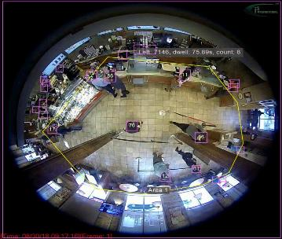
Sales Drivers for VMS and Cloud Storage
Need for easy visibility to view videos from stores or logistics location
Standardization of technology
IT requirements for PCI and SOC II
Risk requirements to share data with third parties with audit trails
Statue of limitation for liability has been extended in most states to 1-2 years
Fiscal year end - budget for enhanced spend on technology
Cost cutting - contract expiration with competing vendor
Adding new locations or expanding or remodeling store

Slide 5
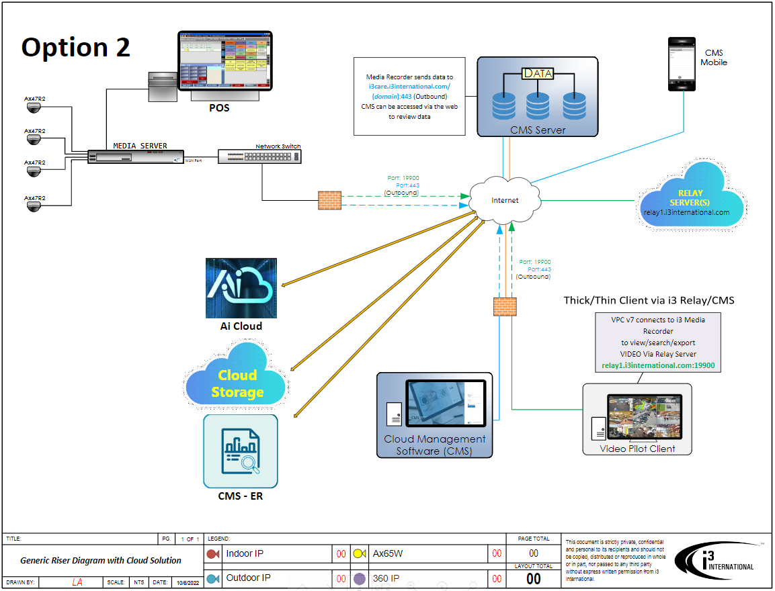

High Level Solution Diagram - Integrated Retail Solution

Slide 6
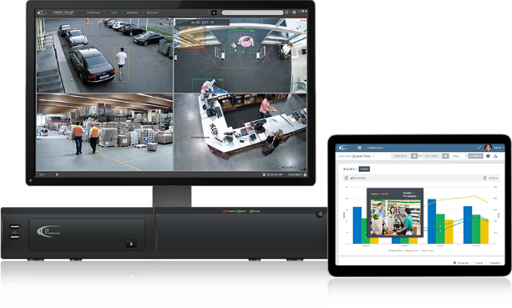
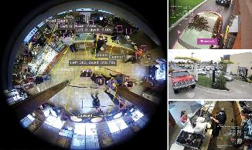
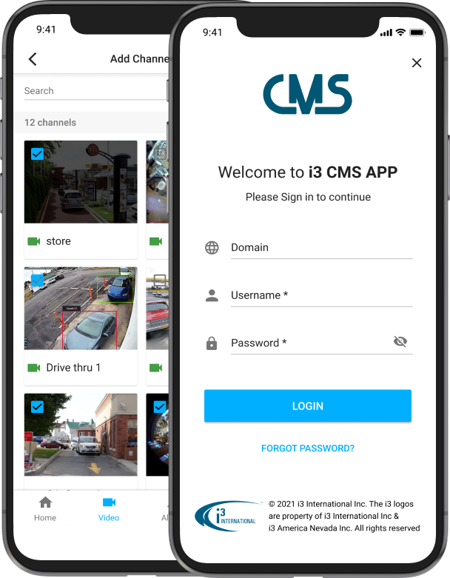
Cloud VMS: Easy mobile access to view and share clips instantly
Platform Demo Video
Ease of use
Fast playback and viewing
Integrated video viewing platforms (VPC, Mobile, Web)
Secure video sharing
Enterprise user management
System updates and health monitoring
Open architecture
Integrated with retail 3rd party software

Slide 7

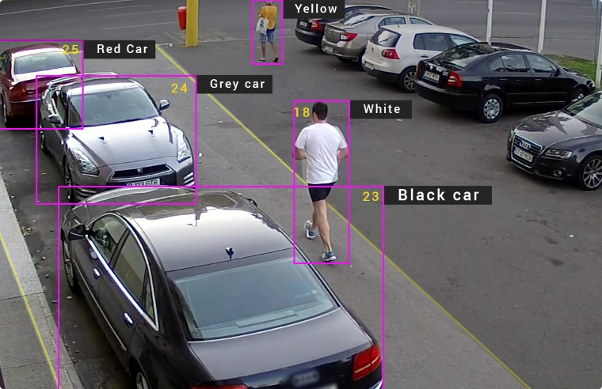
Spotlight Capabilities – Forensic Video Reviewing
Search through large amounts of video quicker using Ai
Using i3’s patented video analytics engine, users can search for faces, License Plate Recognition (LPR), the color of the vehicle or clothes to speed up video review
Notes:
Benefit of i3's smart video solution

Slide 8
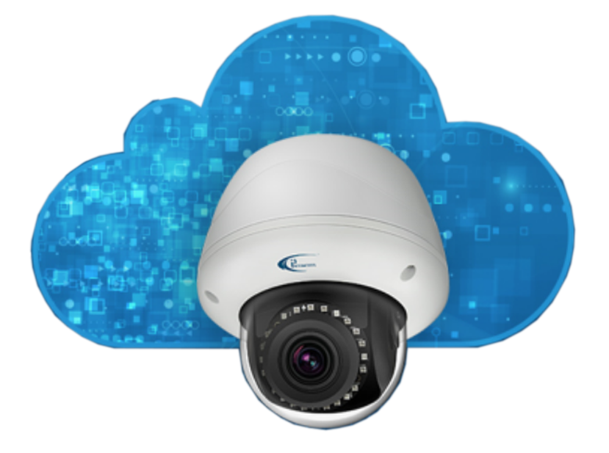
Cost Factors of Cloud Storage
Amount of data required to be retrieved every month
Number of cameras needed to be stored in the cloud
The camera’s frame rate and resolution size
Amount of wait time before data is ready for review
  Glacier
  Immediate

Slide 9

Extended cloud storage
With extended cloud storage, users can now store years' worth of video or share days worth of video through the cloud. The most critical video data is protected and secured in a remote facility.
Notes:
Benefit of i3's smart video solution

Slide 10



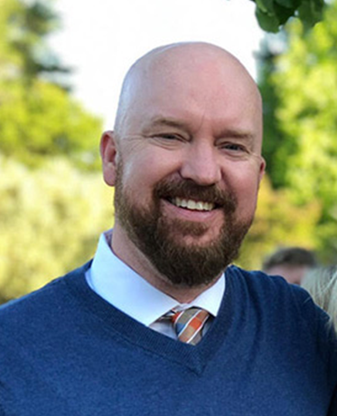


Case Study
75-80 locations currently serviced in 1 state.
Cloud VMS & Extended Storage Solution
12-16 cameras cameras per location
Needed outdoor detection in their donation area that was automated with lights and audio
POS integration
Cloud Storage
Challenges
Needed an extremely easy to use VMS
Customer Quote /Benefits
Tight budget, Small IT team
with a few LP specific members
“The great thing about i3 is its powerful technology wrapped up in an easy-to-use package. Hourly & salaried managers, contract security, sales directors, safety managers, and Loss Prevention all use the VMS platform. i3’s Ai technology has helped us reinvest our labor costing where it was a manual process to an advanced data driven solution.”
- Tim Rout,
Goodwill of Indiana’s Acting Director of Loss Prevention and Safety
Wanted to have entire organization use the solution so that a quick ROI can be achieved
Needed single pane login on all devices

Slide 11



Competitive Landscape for Cloud VMS
Strengths | Weaknesses | Opportunities
Recognizable brand Strong support from integrator community Easy remote viewing VMS Easy to use Cloud Management tool | No Ai retail specific application POS integrations lacks any unique technology Limited integration to POS vendors | OpenEye VARs and end-users will generally like their application. Your angle is to go in through i3’s POS and Ai integrated solution.
Large install base Works with Victor product Large camera integration list Large third party integration list | Higher monthly cost due to manual audits Video application is weak and playback is slow so POS audits may take longer No Ai or trying to establish an Ai engine to integrate to POS | Exacq or Victor is installed in many sites. This solution lack development and innovations. Users of this product will be open to listen to how you can use their existing infrastructure to move them to the cloud, POS and Business Intelligence.
Easy to use Good mobile interface Multiple POS integrations Constantly being updated with new add on services Email notifications- Daily, weekly, monthly 24/7 support Maintain SOC-2 Compliance | Can not view video and exception directly from the box at the site No ability currently to detect customer without transaction or vehicle without transaction | Contracts are very light so switching to another platform will be easier. Push for Ai and an operational tool not just POS integration

Slide 12


Initial Pitch
“Hi (first name of potential customer) ….My name is XYZ and our company has been working with many retailers like “retail-name drop” DG, Five Below, DTLR, Columbia to help extend their current video technology platform to support POS, Ai and Cloud storage. Would you have some time to set up a meeting with a subject matter expert to share some of that info with you?”
Typical Decision Makers
Heads of AP/LP, IT, Legal, Operations or Risk Management
Franchise Owner
Sales Tips
Get the decision maker involved early
Ask pointed Discovery questions besides BANT:
  Does your current system support mobile and the cloud?
  Does your current solution meet PCI and SOC II requirements?
  Can everyone in your organization have access to the video platform?
Tailor proposal with their needs with minimal options
Understand their costs and provide ROI
Typical Influencers
District Manager or General manager
Ops/facility manager
Franchise Board, Investor Groups or Advisory Groups
Consultants and Secondary Vendors (POS companies)
Industry groups/sites: RLPSA, LPM, QSR magazine

Slide 13
Cloud VMS & Extended Storage - FAQs
How does the i3 Cloud VMS solution compare with OpenEye, Exacq/Victor, Hanwha-Techwin ?
What are the key components I need to talk about in the VMS to get the decision maker’s attention?
What are the cost implications for long term storage ?
Who in the organization is looking for long-term storage?
Will we support a POC? Maximum length?
What key integrations are important to understand?

