Slide 1
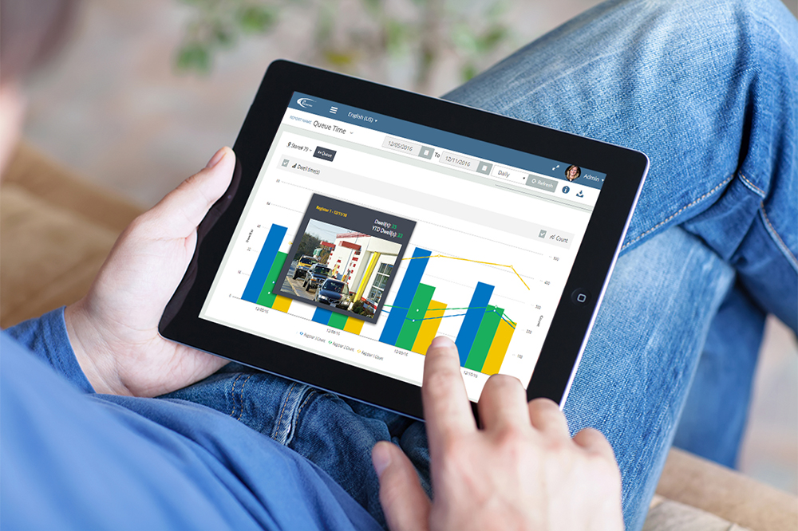
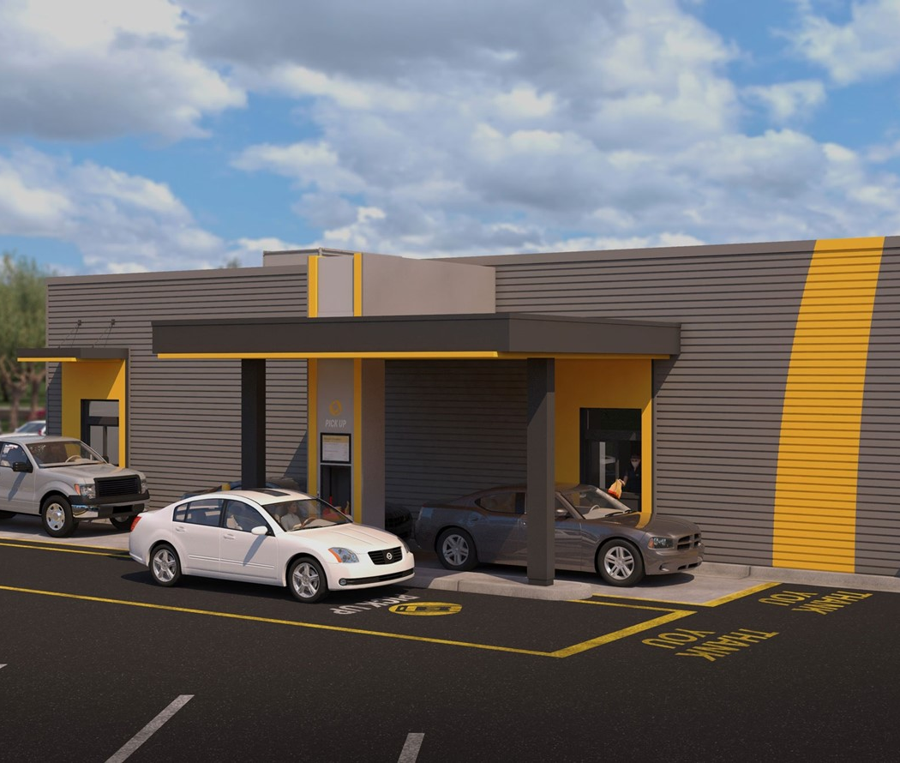
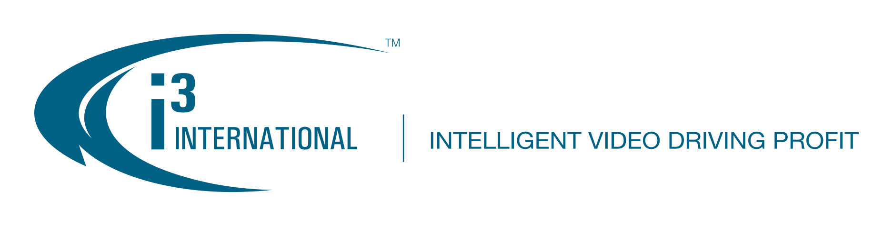
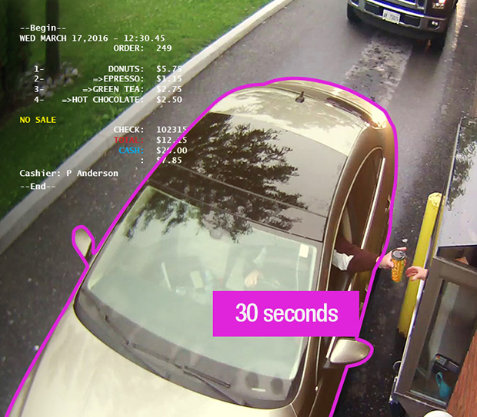

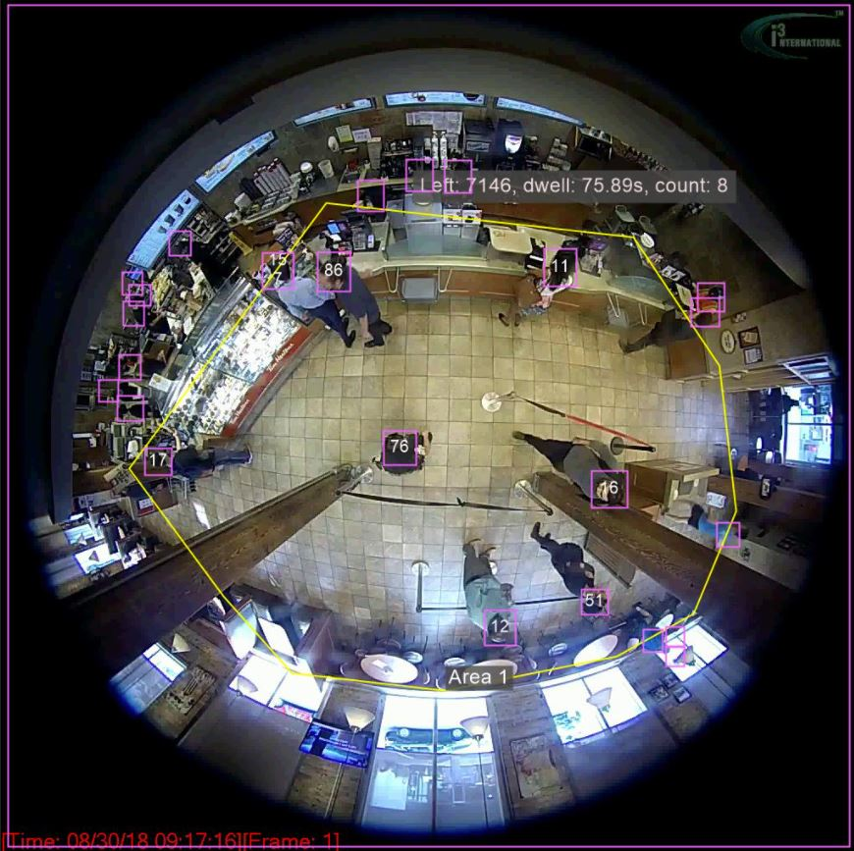
Enhancing your drive-thru timer with Ai, machine learning, video & system integration
C #003 – 1.23 sec
C #005 – 1.32 sec

Slide 2
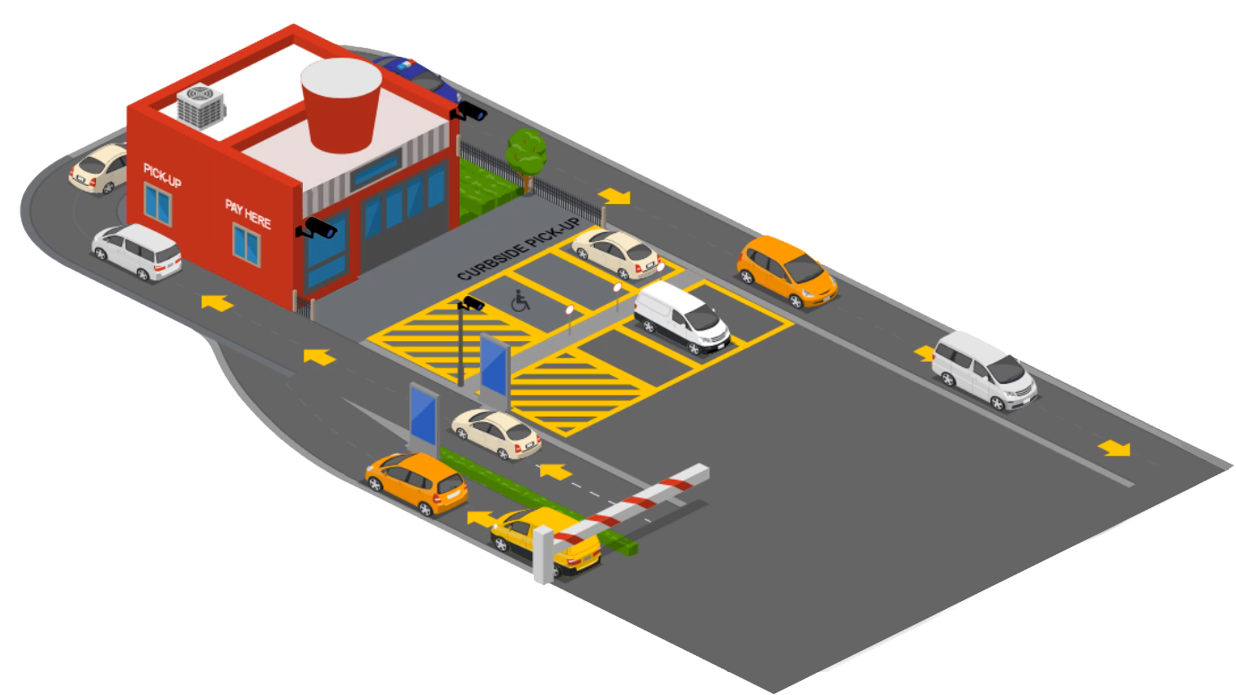

Slide 3

Agenda
Introduction
The opportunity
Understanding how video analytics and machine learning can enhance your drive-thru technology
What does the solution look like in your restaurant?
Cost comparison
Next steps

Slide 4


The Company
i3 International is a 35-year-old privately held technology company that operates like a start up.
Offices
140
i3 Difference
Canada
US
Vietnam
Taiwan
Employees with a strong focus on software development in the field of digital video, artificial intelligence (Ai), machine learning (ML) & cloud hosting services
We hold several patents and decades of know-how in the fields of video processing, data analytics, and computer vision

Slide 5
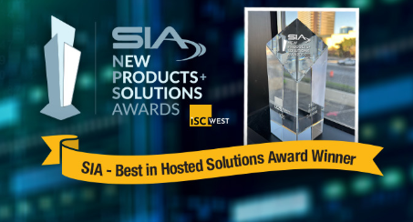

Slide 6
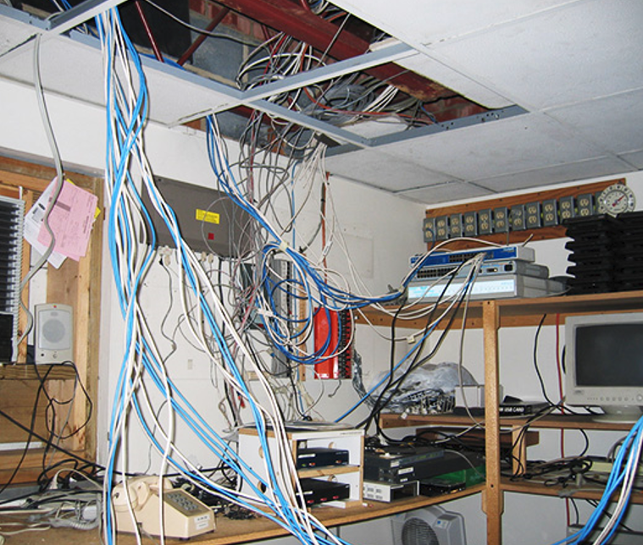

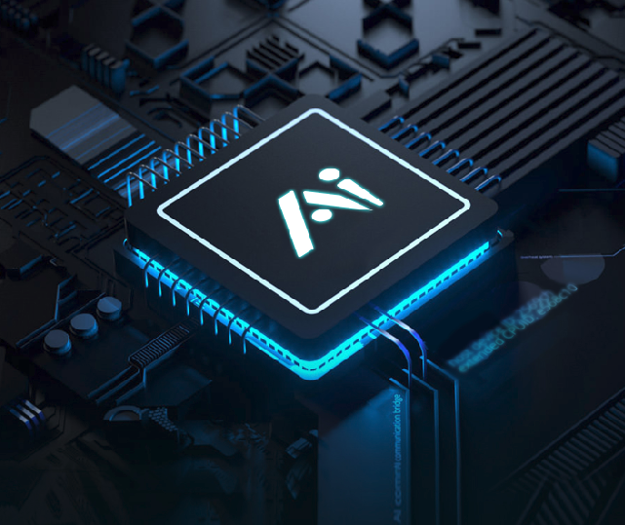
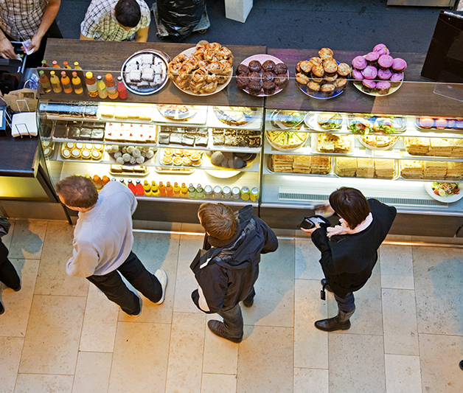

The Problem
Analog Platform
User Frustration
No Ai or machine learning
Inside service time
Cost savings
The drive-thru HW technology has not been improved for the past 20 years
Current drive-thru system can be manipulated & the data is not integrated to video or POS in real-time
Current drive-thru platform offers no Ai or machine learning to help operators gain deeper insight into their operation & customers
There are currently no cost-effective solutions to measure speed of service for the inside of the store.
There is a substantial opportunity to reduce cost for the operator while greatly enhancing the solution

Slide 7



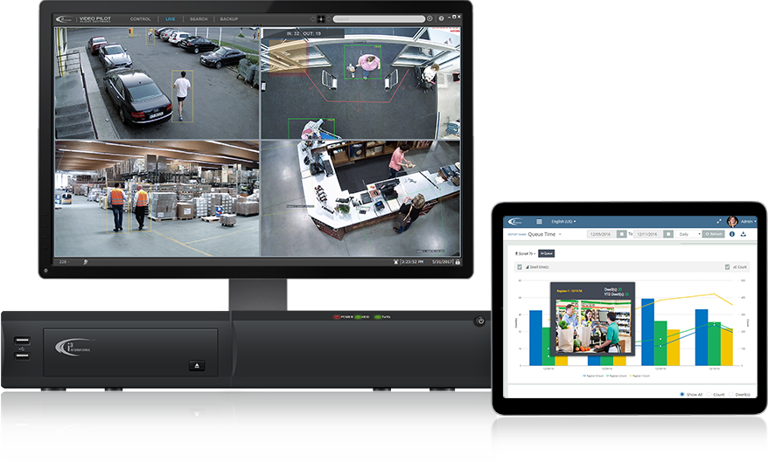
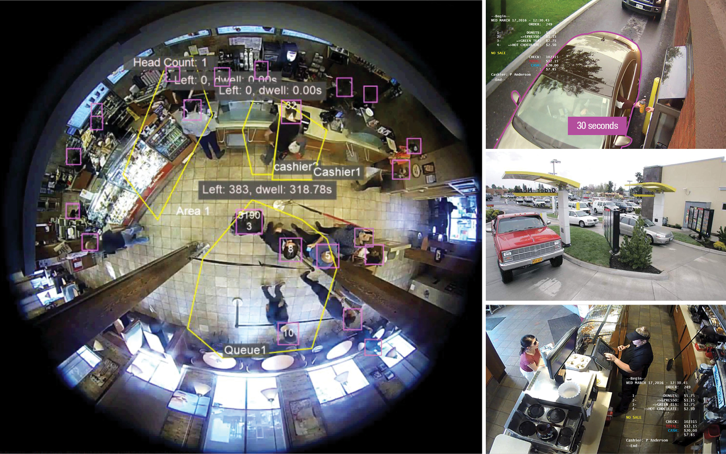
How we can help with this challenge
Full turn-key solution
i3 can provide a full turn-key solution to reduce the total cost of ownership.
i3 is a secure interconnected platform that integrates to third-party devices such as the POS, video system, and other restaurant equipment to give the operator new insight into their customers and operation.
Integrated platform
Secured cloud connection
i3 can assist in delivering this integrated data in real time, across a secure cloud network, encouraging positive behavior from staff members to improve sales and maximize output.

Slide 8

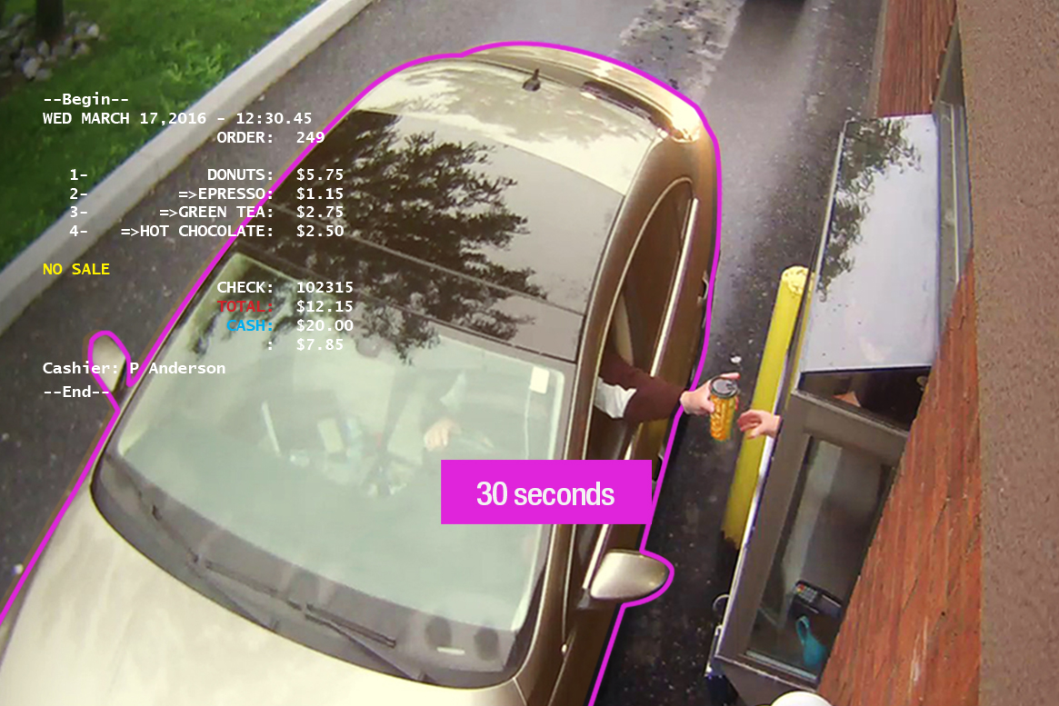

How Ai & machine learning can benefit my QSR operation

Slide 9

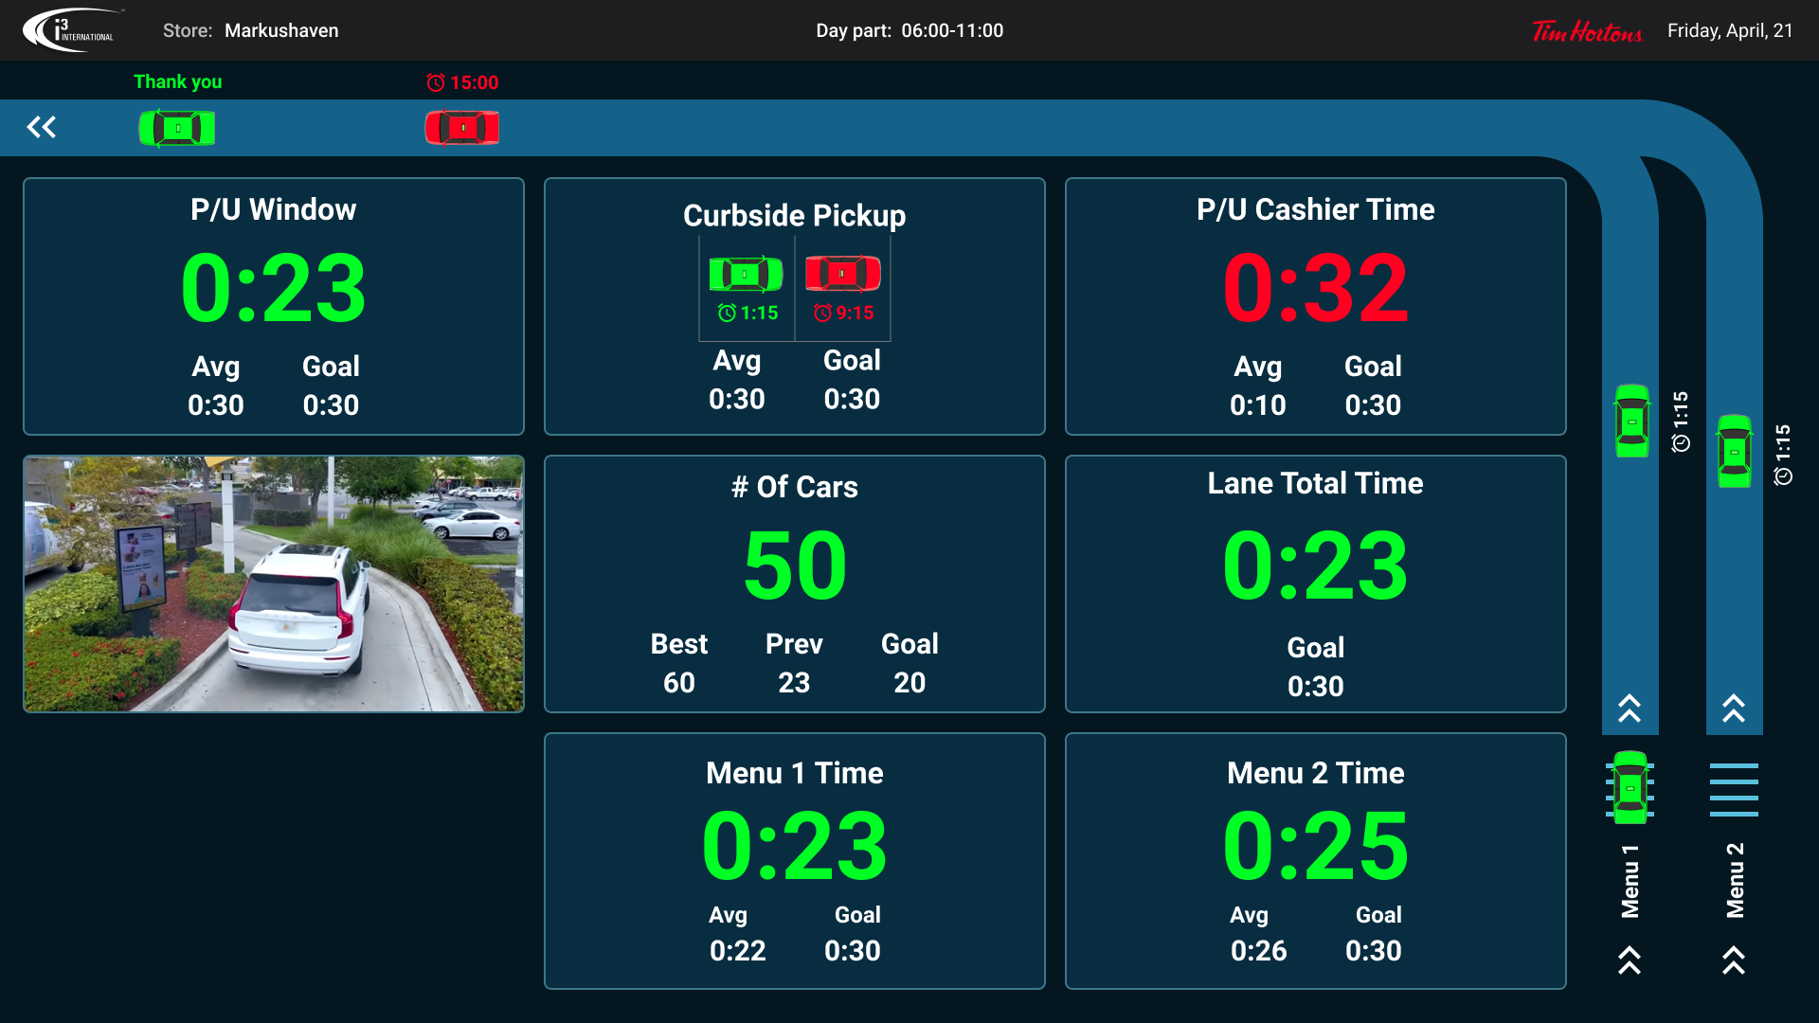
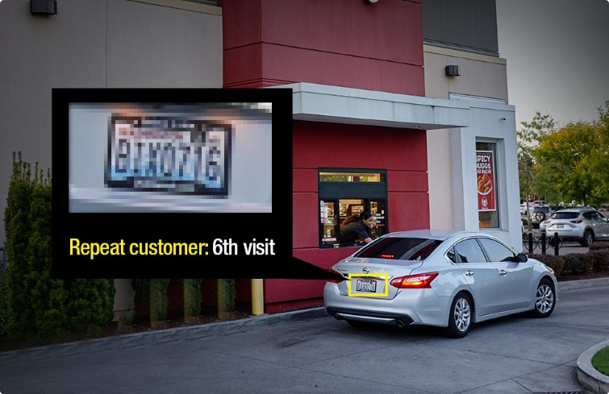
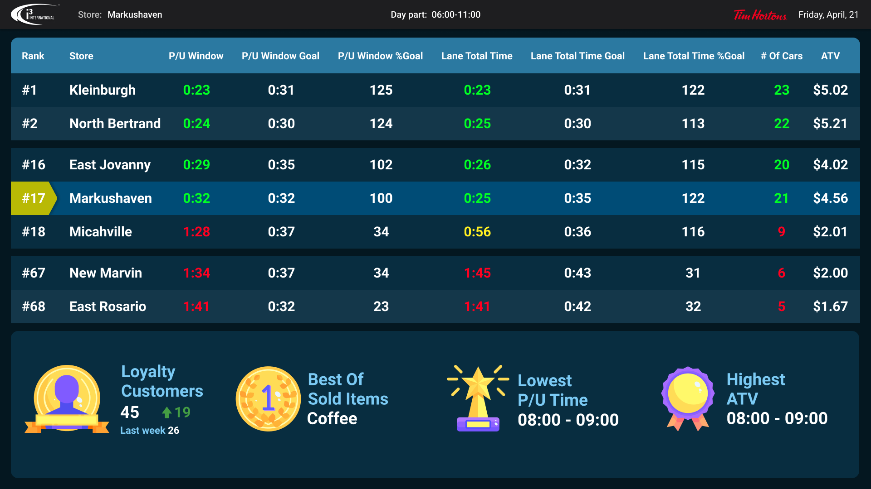
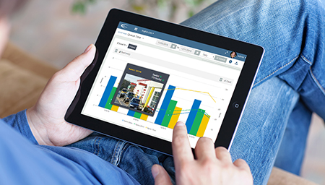

Velocity Timer
The Velocity drive-thru timer is the only timer that enables operators to dramatically improve their speed of service metrics at the drive-thru, curbside and front cash.
Integrated platform – non loop detection
Ai & ML
Leader board, gamification & upselling
Enhance reporting tools
Most advanced drive-thru systems that can be integrated into your video and POS system in real-time
i3’s Ai engine can help operators measure inside/outside speed of service and repeat customers
Support real-time data output such as leader board, gamification & upselling to keep your staff engaged and motivated
i3’s integrated platform allows the operator to make informed decisions to help increase their revenue & store performance
Notes:
Benefit of i3's smart video solution

Slide 10



Benefits
Price guarantee
Life-time warranty & updates
Online diagnostic
i3’s price match guarantee ensures that the most advance drive thru timer is also the most affordable
Any Velocity timer connected to i3’s CMS will have full coverage from manufacture defects for the lifetime of the contract * (please ask your sale rep for details)
i3 can help deliver real-time support to the operator and business through our online diagnostic tools to ensure uptime
10
Notes:
Benefit of i3's smart video solution

Slide 11
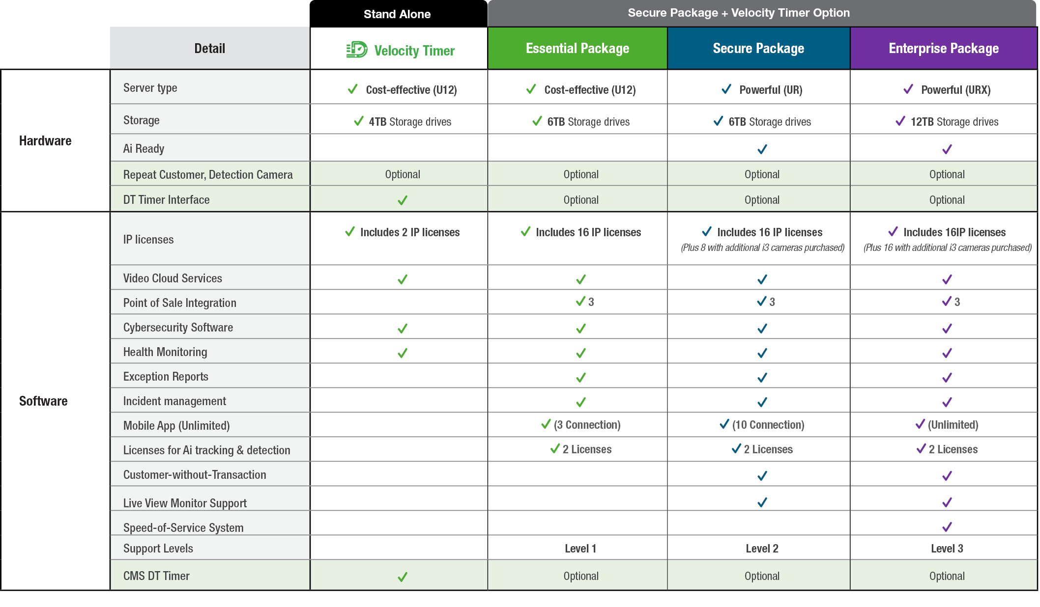
Understanding my solution options

Slide 12
Cost comparison?
Velocity Timer
 | MSRP | Total
Cost of Timer | $2395 | $2395
Monitor | $200 | $200
Leader board, gamification, reports | included
Installation | $525 | $525
Warranty | 1yr/LOC
Cloud connection fee annually | $268 | $268
Repeat customer detection (LPR) | $750
Total |  | $3388
Nitro Timer
 | MSRP | Total
Cost of Timer | $2569 | $2569
Monitor | included
Leader board, gamification, reports | included
Installation | $525 | $525
Warranty | 1 yr
Cloud connection fee annually | $260 | $260
Repeat customer detection (LPR) | N/A
Total |  | $3354
Summit Timer
 | MSRP | Total
Cost of Timer | $2795 | $2795
Monitor | included
Leader board, gamification, reports | included
Installation | $525 | $525
Warranty | 2 yrs
Cloud connection fee annually | $244 | $244
Repeat customer detection (LPR) | N/A
Total |  | $3564
HW & SW
 | Ai & ML to measure inside speed of service and repeat customers
 | Real-time POS integration
 | Integrated to video
 | Remote diagnostic
 | Mobile App
X | Ai & ML to measure inside speed of service and repeat customers
X | Real-time POS integration
 | Integrated to video (3rd party)
 | Remote diagnostic
 | Mobile App
X | Ai & ML to measure inside speed of service and repeat customers
X | Real-time POS integration
X | Integrated to video
 | Remote diagnostic
 | Mobile App
Advantages

Slide 13


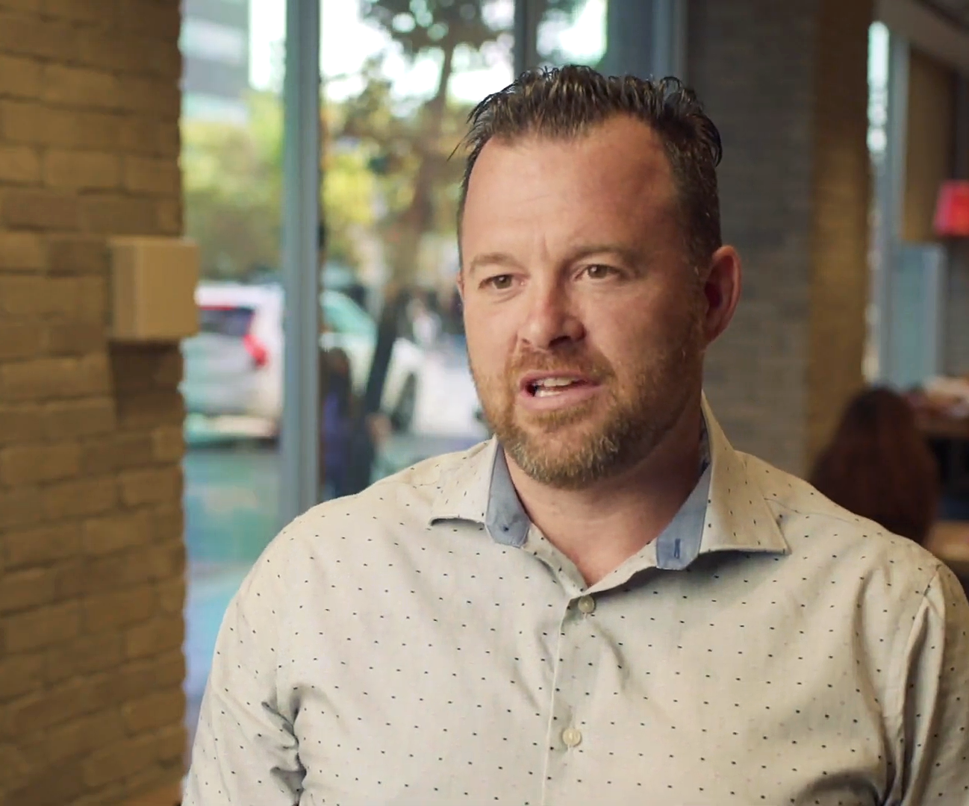
What our customers are saying
“With i3 Ai solution, integrating my security system and cameras with my POS system allows me to be able to analyze traffic patterns, transaction times & transactions counts. It has given me a better understanding of what my throughput at different points of the day and allows me to analyze how my staff are doing, and how quickly we are turning over each transactions. This real-time actionable data is a game changer for our business.”
- Jason St. Croix, Franchisee owner, Tim Hortons

Slide 14

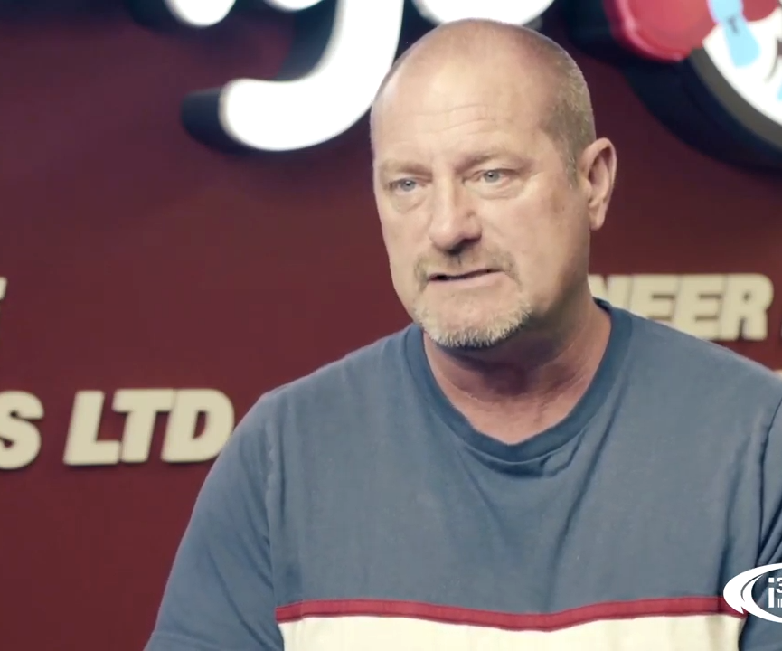
What our customers are saying
“The i3 system has allowed us to run a more secure and safe restaurant. This organization is amazing to work with and I would highly recommend the i3 solution.”
− John Ribson, Owner/Operator at Wendy’s

Slide 15

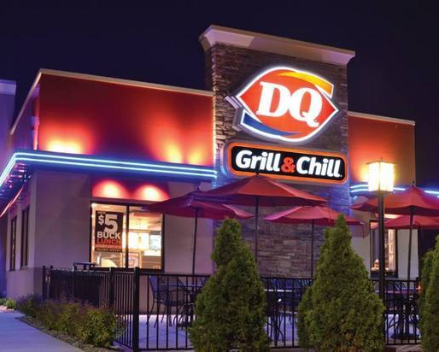
What our customers are saying
“The level of integration allows for relevant information, presented effortlessly in one location. Powerful video analytics, allow myself to focus on other tasks versus investigating suspicious activities, also activities that may have been missed via human limitations.”
− Andrew Colbourne, Franchisee owner, DQ
Play video

Slide 16

Next Steps?
Click here
www.i3international.com

