Slide 1

Week 1
QSR
Smart POS Exception Reporting
Business Insights
Drive-thru
Week 2
Retail
Cloud VMS & Extended Storage
Smart POS Exception Reporting
Business Insights
+
Training
Series
Week 3
Grocery
Smart POS Exception Reporting + Integrated VMS
Business Insights & Encrypted Video Download
Week 4
C-Stores & Carwash
Incident Reporting & Cloud Storage
POS Reporting & Business Insights

Slide 2
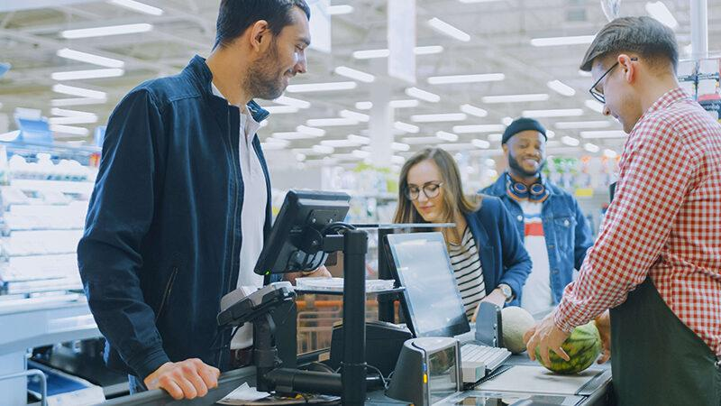
Smart POS Exception Reporting + Integrated VMS
Driving Profitability

Slide 3
Business Drivers
High Level Solution Diagram & Use Cases
Exception Based Reporting Demo
Case Studies
Competition
Sales Summary: Buyers & Pitch
FAQs
+
Training
Agenda

Slide 4
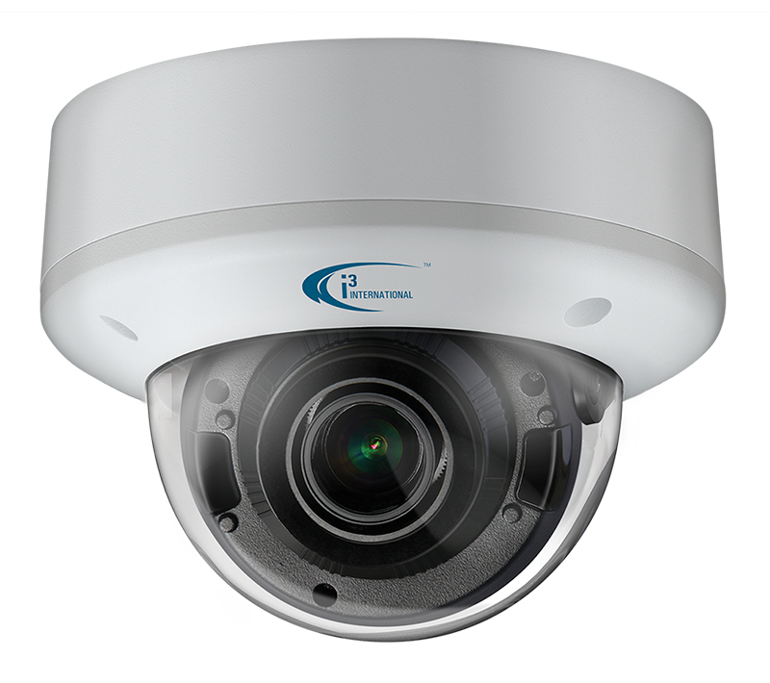
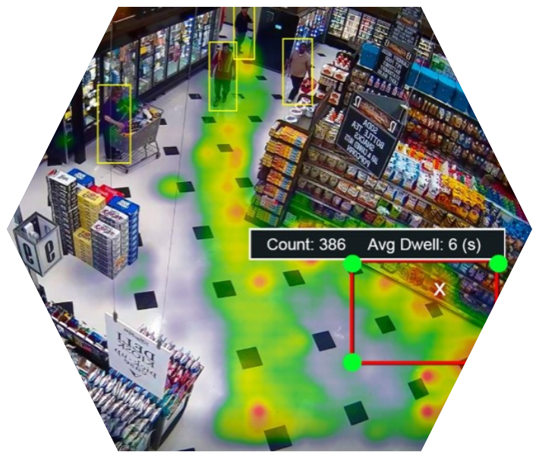
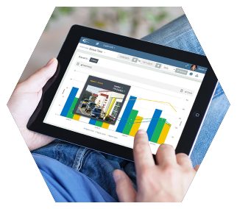
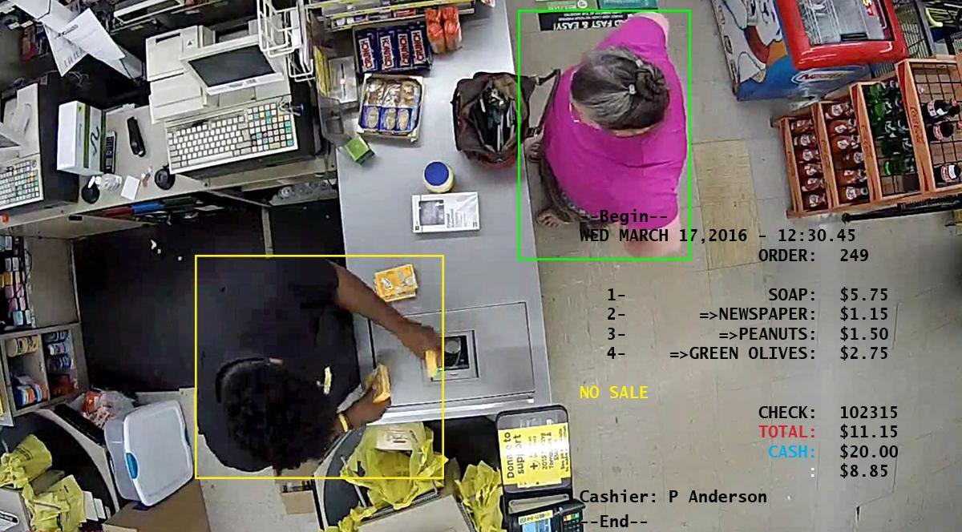
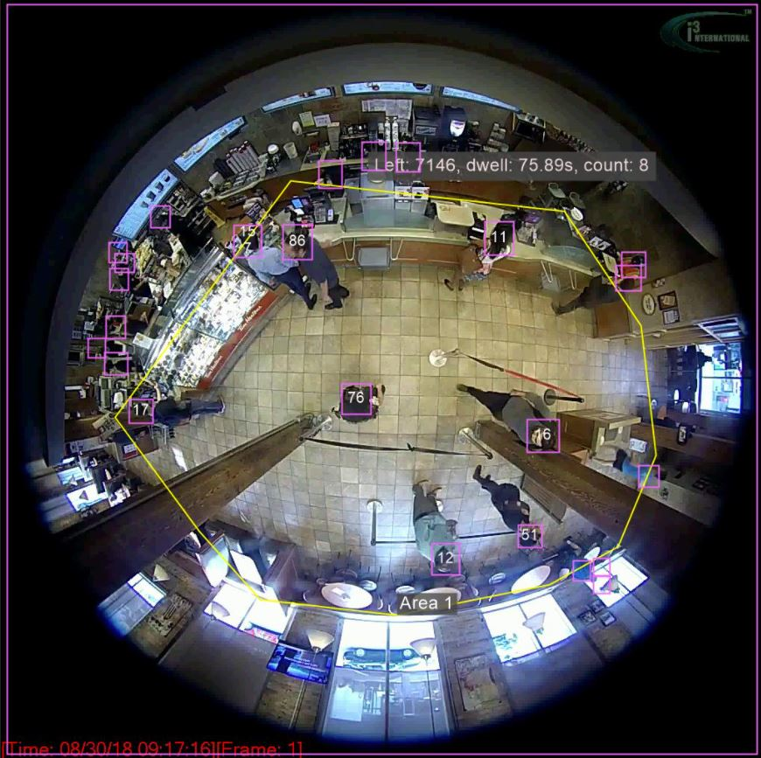
Sales Drivers for Grocery POS Exception Reporting
Network restrictions make it harder for grocery team members to access systems
Consolidation and mergers in the EBR space - increased solution cost and reduced personalized service
Need to control loss and eliminate internal theft
Shortage in labor - need to reduce AP group’s time for investigations
Tougher PCI/PII Compliance needs are forcing some operators to change platforms
Adding new locations or expanding or remodeling stores
Contract expiration on current vendor- cost cutting opportunity
Fiscal year end - tax benefits and budget overflow for tech spend

Slide 5
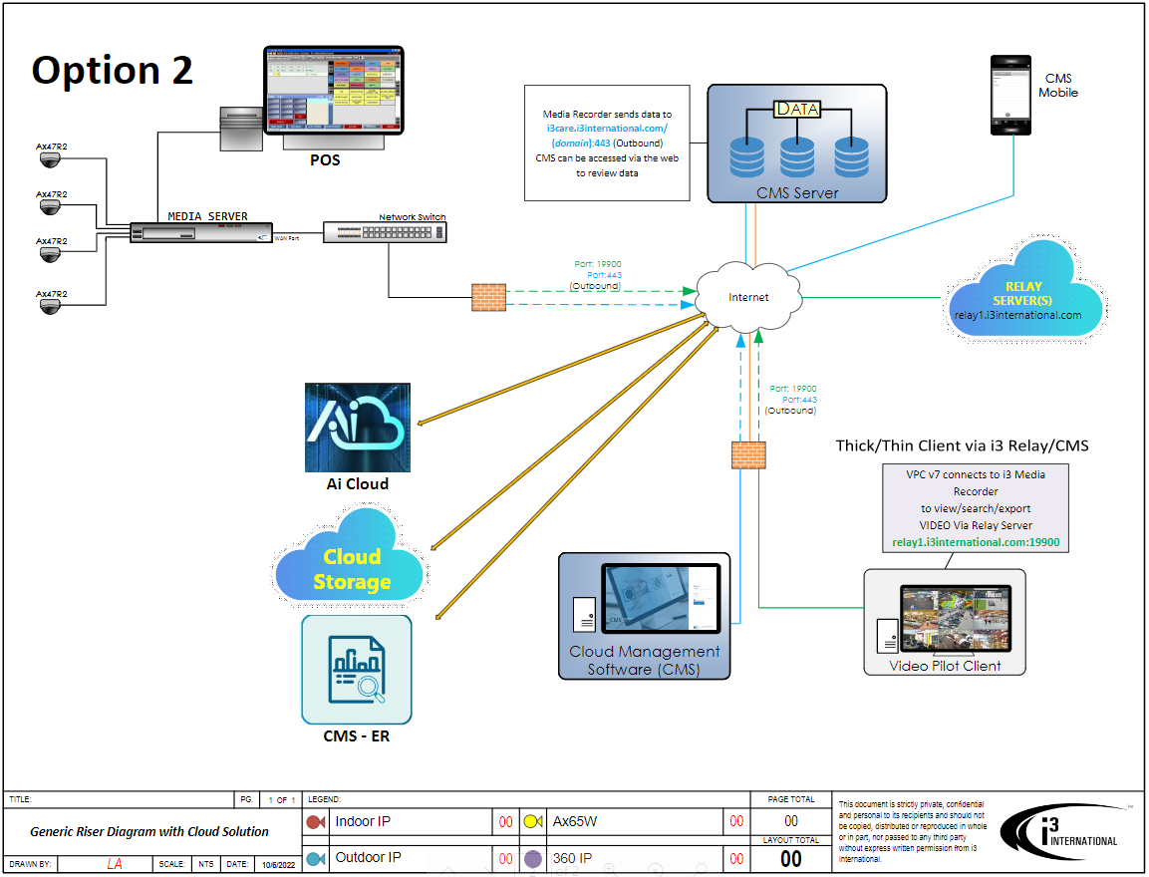

High Level Solution Diagram of Grocery Network Topography
VPN

Slide 6
High Level Solution Diagram - Cloud POS integration

Slide 7
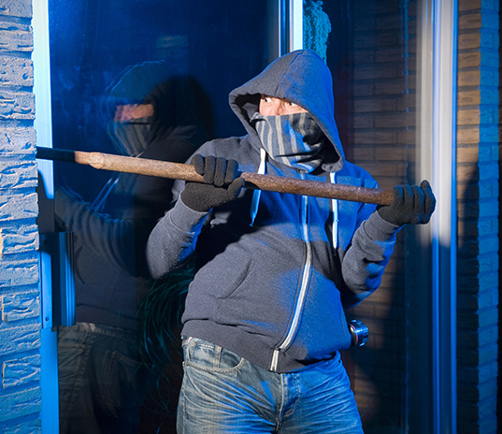
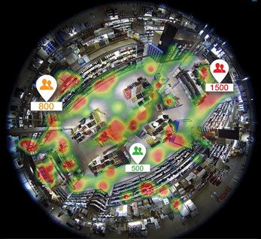
Challenges for Grocery Loss Prevention Teams
Grocers want to find a cost effective, versatile video solution that can be securely accessed and managed to improve security, reduce theft & enhance customer service.
Vendors must show that they can achieve a positive ROI for the organization in six months or less.

Slide 8
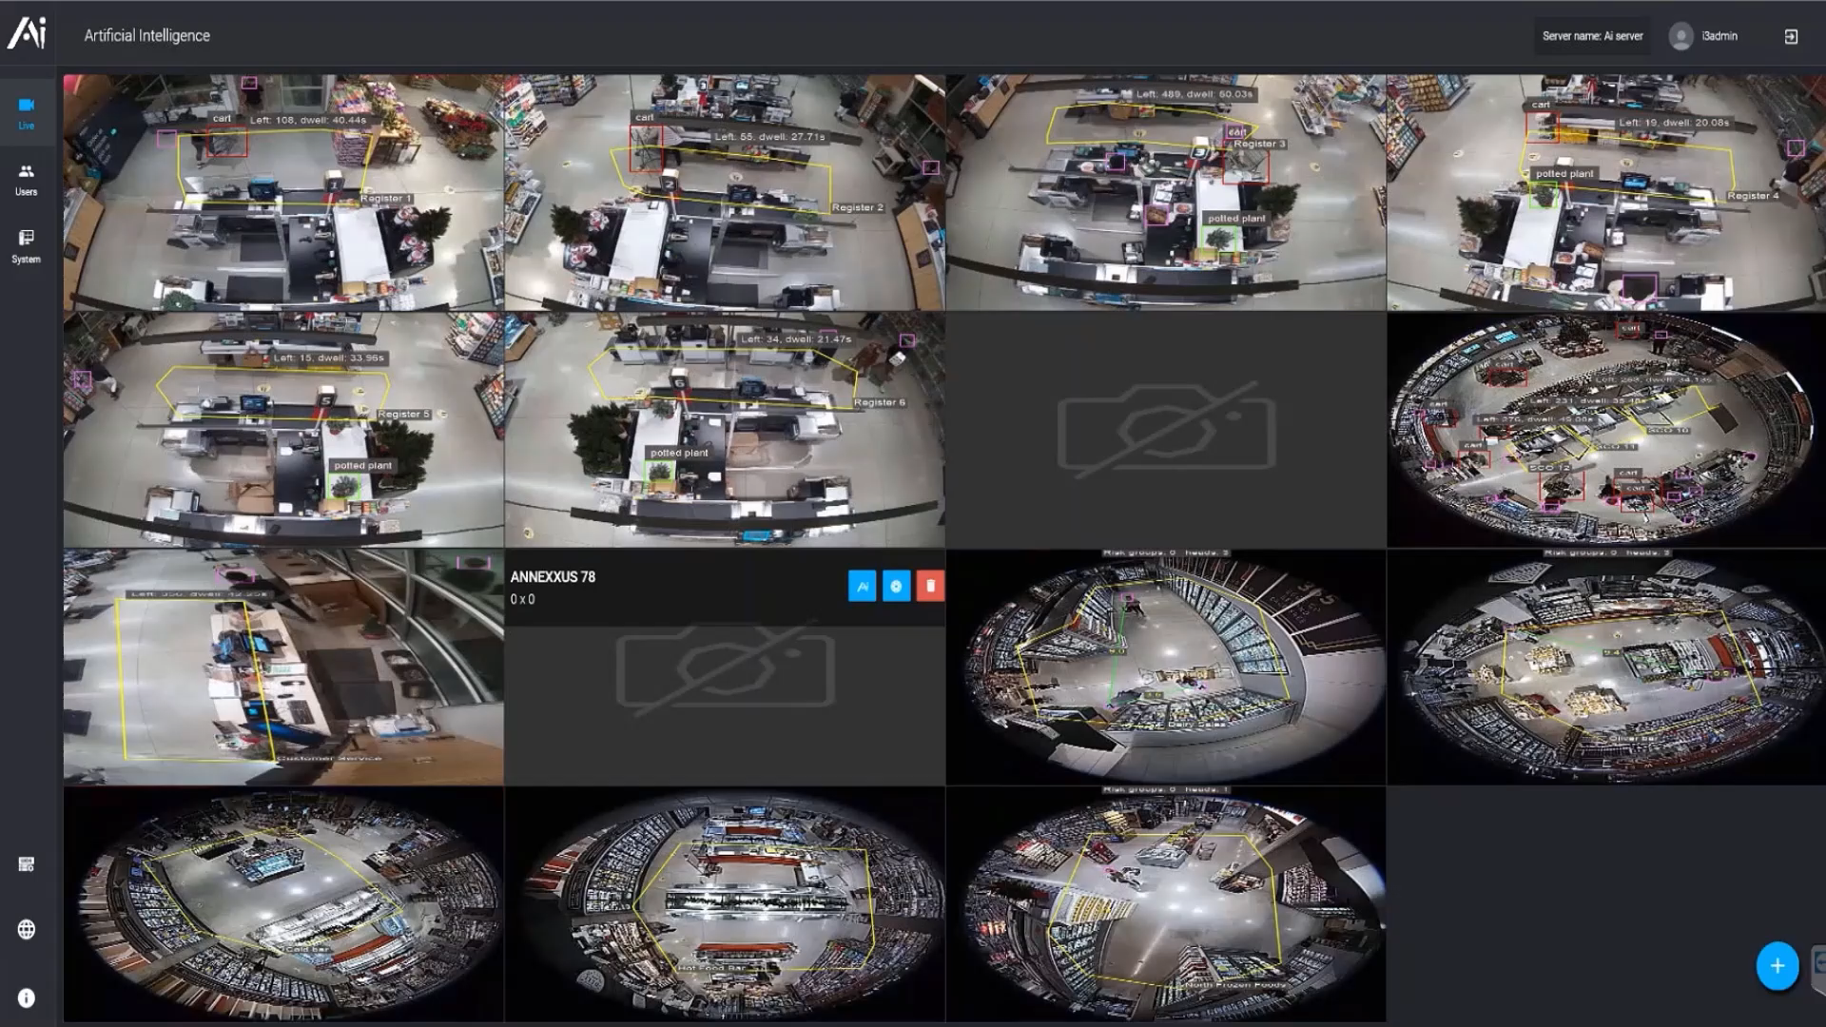

How AI & machine learning can benefit the grocery segment
Play Video
Notes:
Benefit of i3's smart video solution

Slide 9

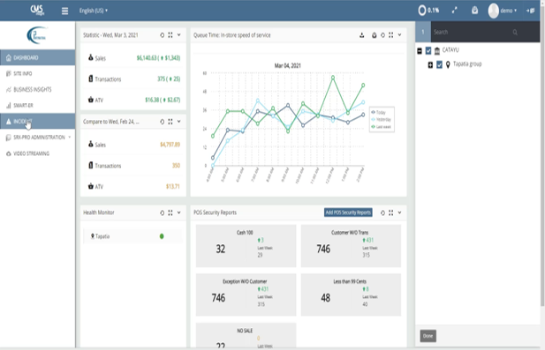
Stop employee theft at the till by using i3’s data analytics engine
By integrating video with POS data and applying i3’s data analytics engine, operators can detect potential theft due to till manipulation before it become rampant.
Play Video
Notes:
Benefit of i3's smart video solution

Slide 10
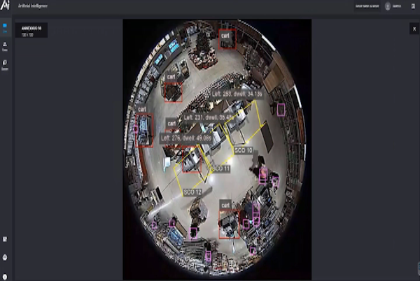
Detect and deter refunds & suspended transactions
i3’s patented video analytics engine with integrated POS data can help detect and deter suspended transactions and refunds without customers
Play Video
Notes:
Benefit of i3's smart video solution

Slide 11
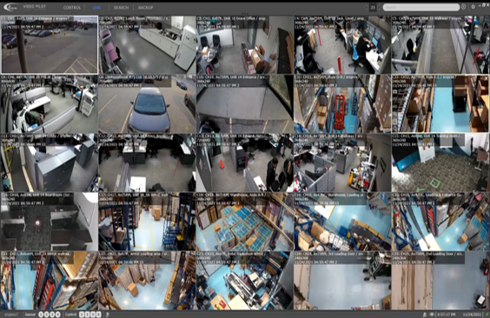
Search through large amounts of video quicker with the use of AI
Using i3’s patented video analytics engine users can search for faces, LPR and the color of the vehicle or clothes to speed up video review.
Play Video
Notes:
Benefit of i3's smart video solution

Slide 12






Case Study
31 locations with 1.3B in sales
VMS with POS Exception Reporting
100-130 cameras per store
Multiple media servers on site that needs to be accessed by multiple departments
Needed POS-EBR to be user friendly
Challenges
Regional chain that has to compete with larger brands
Customer Quote /Benefits
Fast growth, Small IT and LP team
“I would definitely recommend i3 to others. When we have an issue, they are quick to respond, and we get all of our information in one place.”
Chris Vandiver - Loss Prevention Manager, Cosentino's Food Stores
Always pushing for the best technology at the best price
Needed single pane login and view for all cameras

Slide 13
Top Referenceable Grocery Customers To Name Drop With Prospects
Customer | Solution Highlights | Locations
Weis Markets | POS integration with video to detect losses at the till | +200 locations across the USA
Cosentino | One of i3’s longest grocery customers - updated their system over 25 years | +35 including logistics centers
Harris Teeter | Full implementation and the only Kroger chain that was allowed to keep, updates and maintain its unique system topography | Full locations roll-out
Heines | Developing customer - will be testing cloud video in 2023 | +45 locations
Basha Foods | Mix of analog, HD and IP cameras across different regions. Video system needed to be integrated to POS. | All locations
Vallarta | Local regional grocer with large camera footprint. Video needed to work seamlessly on a small bandwidth pipe. Solution is being expanded in 2023 to include operations and marketing departments. | +50 locations
Whole Foods Markets | Mid-tier grocer with 500 locations. Currently deploying EVT, AI concierge level one support and EBR in 2023 | +390 location

Slide 14



Competitive Landscape for Retail POS Exception Reporting
Strengths | Weaknesses | Opportunities
Established name brand within retail Large corporation with a specialty in health and retail Many operators use many parts of Appriss SW components to run their retail Has a large development and support team Strong predictive data engine Large legacy customer base | Expensive and price is increasing Service is lacking due to merger and consolidation of Sys. Republic and Aspect LP Over promise to keep the customer and often under deliver | Appriss is expensive and has underperformed. Many retailers are starting to look at other options to replace their old Aspect solution because they do not want to shift to the new Secure platform. With multiple EBR companies being purchased by large firms including Aspect and Sys-Republic services, pricing is starting to change.
Known for their technology in supply chain Profitec by Zebra is known for its data analysis beyond AP/LP Can tie in inventory data and logistic data to help give a more complete store picture in the retail business | Recently purchased by Zebra and will have some internal competition against the other Zebra brands Support is waning since most of their core people have left | The opportunity with Profitect is that they were a specialty company with a focus on data analytics for AP. Unfortunately, with the purchase by Zebra a lot of their former customers are not getting the same service. Enquire if end-users are happy with their current platform. Pitch to enhance their existing functionality with video Ai and get a small piece of the business to start. Offer a POC.
Great support and onboarding Easy to use and train on Strong in grocery and pharmacy Strong list of integration partners including i3 Cloud Based Analytics | High upfront cost to parse the POS data Video application playback is weak No Video AI engine to improve EBR reports | Many operators are dissatisfied with their current platform. Pitch them a POC to enhance the EBR functionality with Video AI and start with a small part of their business.

Slide 15


Initial Pitch
“Hi (first name of potential customer) ….My name is XYZ and our company has been working with many grocers like “retail-name drop” Whole Foods, Weis Markets, Harris Teeter, to help extend their current video technology platform to support AI with integrate POS. Would you have some time to set up a meeting with a subject matter expert to share our use cases and benefits to retailers like you?”
Typical Decision Makers
Heads of AP/LP, IT, Risk Management
Owner
Sales Tips
Get the decision maker involved early
Ask pointed Discovery questions besides BANT:
  Do you have a scalable cloud base video system?
  Does you're existing EBR system integrate with video?
  Does your current EBR system integrate with video analytics to enhance fraud detection?
Tailor proposal with their needs with minimal options
Understand their costs and provide ROI
Typical Influencers
District Manager or General manager
Ops/facility manager
Franchise Board, Investor Groups or Advisory Groups
Consultants and Secondary Vendors (POS companies)
Industry groups/sites: FMI, LPM, RILA, NRF

Slide 16
POS Exception Reporting - FAQs
What are the key business drivers for Grocery POS Exception Reporting & VMS tools?
What types of cameras are supported ?
What are the key stages in a POS implementation project?
What is the duration of a typical project ?
Will we support a POC? Maximum length?
What key integrations with other grocery apps and key POS systems are important to understand?
How do I pitch against someone who has Solink, Agilience or 3XLogic as their POS exception reporting tool?

