Slide 1

Week 1
QSR
Smart POS Exception Reporting
Business Insights
Drive-thru
Week 2
Retail
Cloud VMS & Extended Storage
Smart POS Exception Reporting
Business Insights
+
Training
Series
Week 3
Grocery
Smart POS Exception Reporting + Integrated VMS
Business Insights & Encrypted Video Download
Week 4
C-Stores & Carwash
Incident Reporting & Cloud Storage
POS Reporting & Business Insights

Slide 2
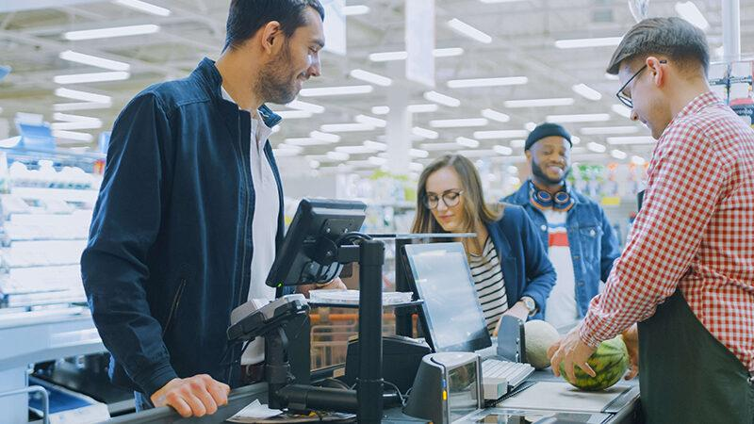

Business Insights & Encrypted Video Download
Driving Profitability

Slide 3
Business Drivers
High Level Solution Diagram & Use Cases
Business Insights & Encrypted Video Download Demo
Featured Customer Case Study - Whole Foods
Competition
Sales Summary: Buyers & Pitch
FAQs
+
Training
Agenda

Slide 4
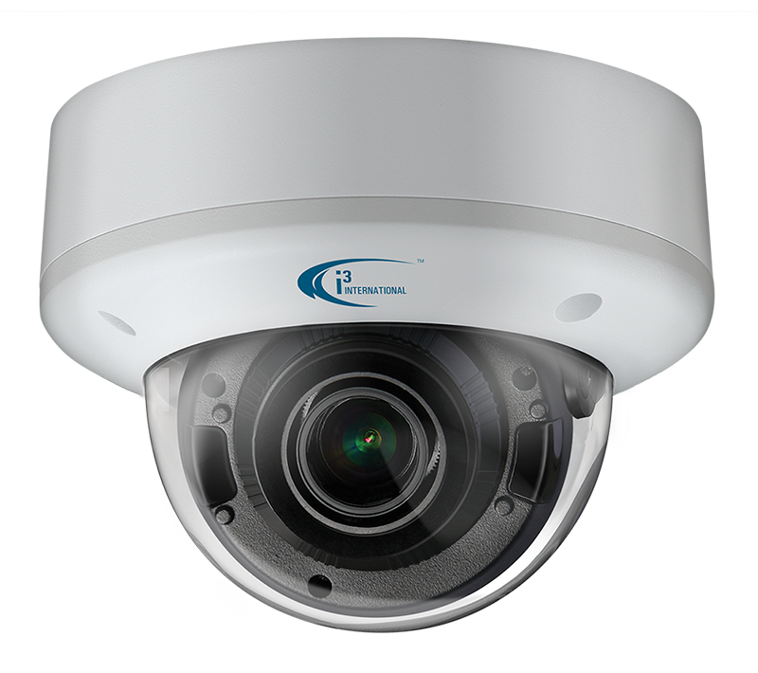
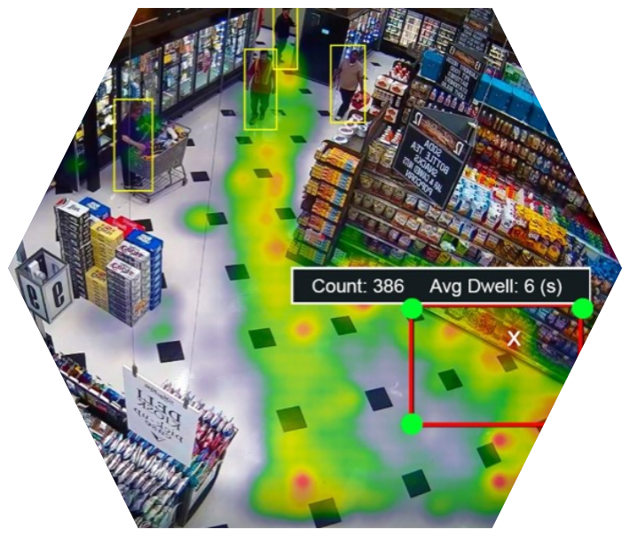
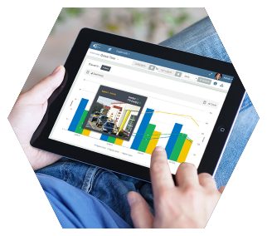
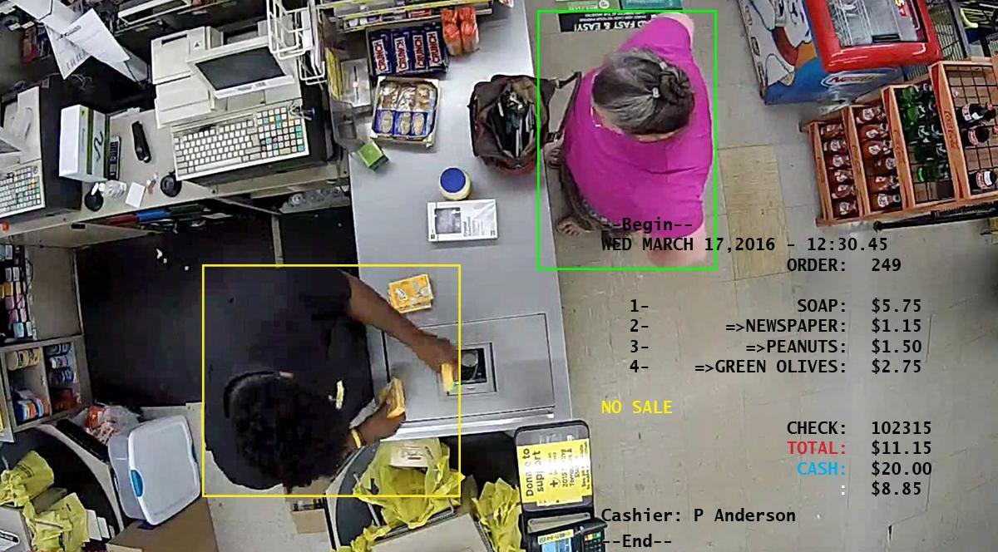
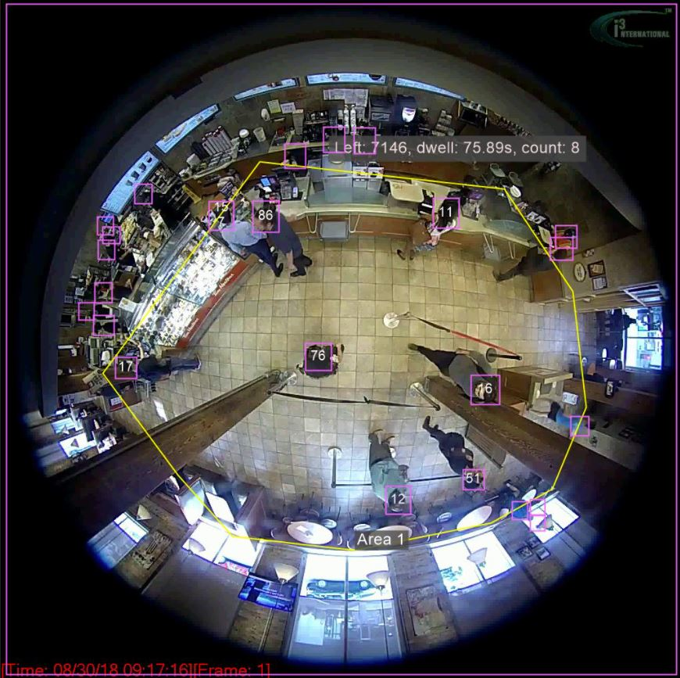
Sales Drivers for Grocery Business Insights & Encrypted Data
AP leadership wants their security dollars to go further and to drive the discussion beyond shrink control
AP leadership wants to stay relevant with other business units
Executives are looking for solutions to improve customer service
Executives are looking for actionable metrics to make decisions that will impact P&L
Grocers are interested in what their competitors are doing with AI
Risk departments are looking for a secure method to transfer large amounts of video data

Slide 5
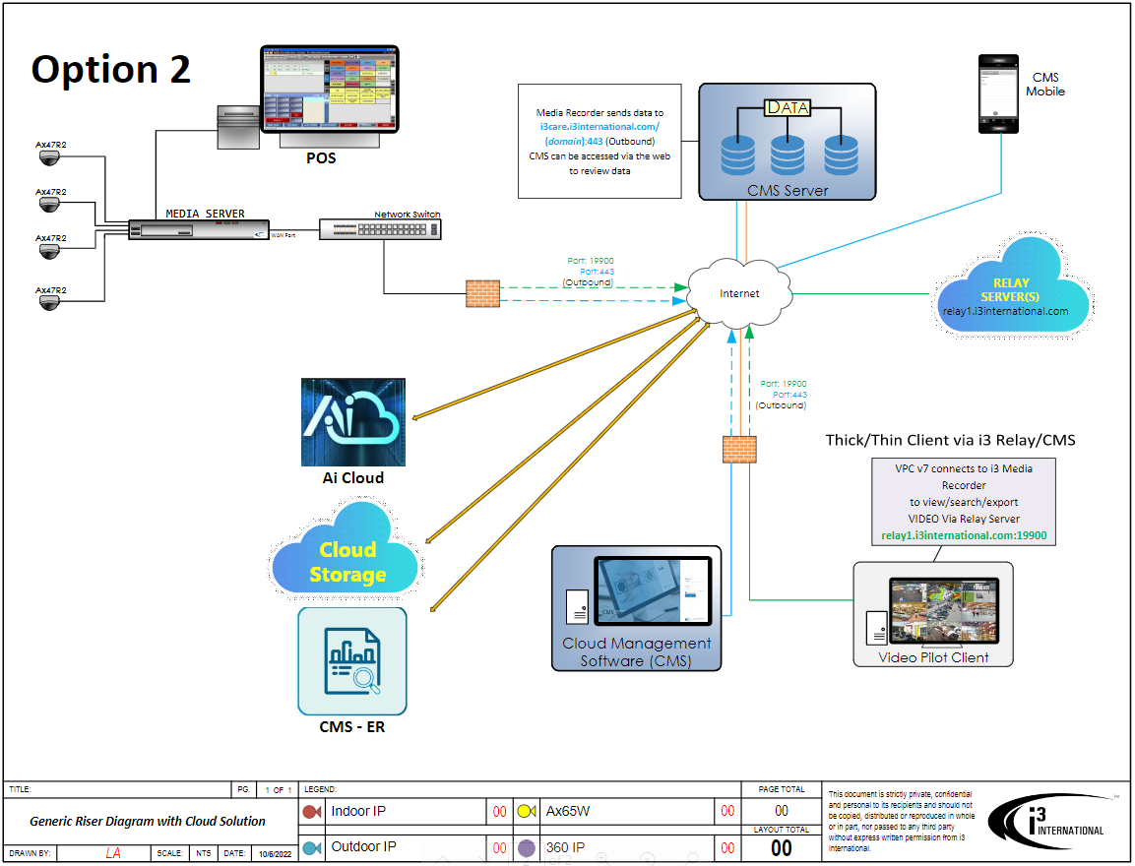

High Level Solution Diagram of Grocery Network Topography
VPN

Slide 6
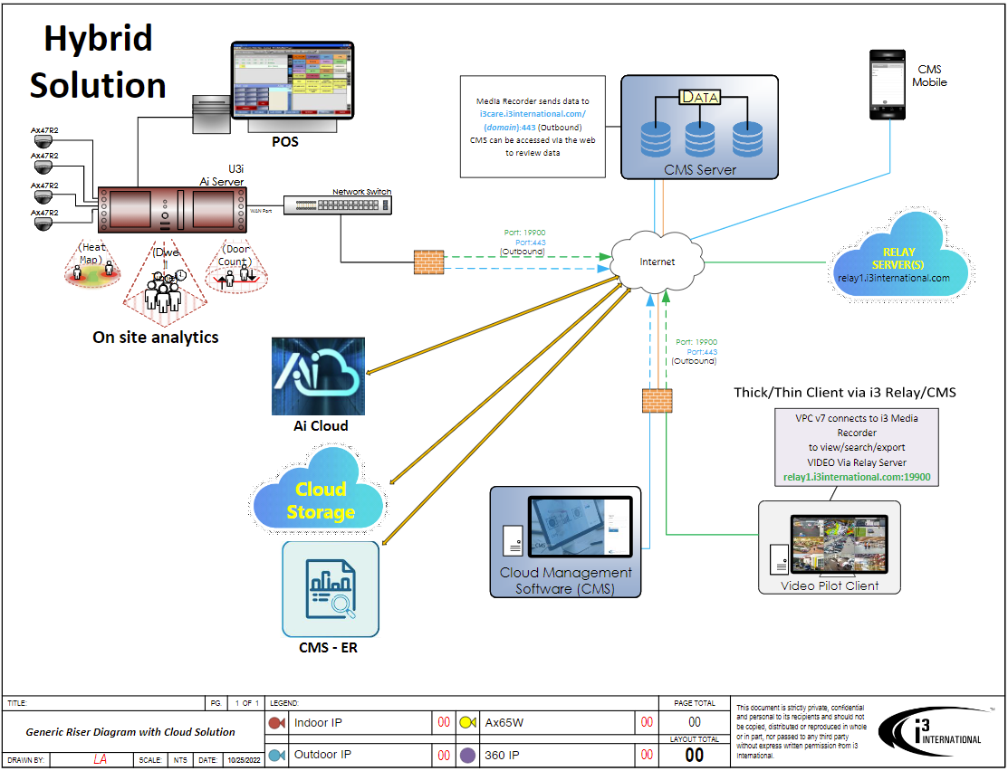
High Level Solution Diagram - Hybrid Ai Solution Integration

Slide 7
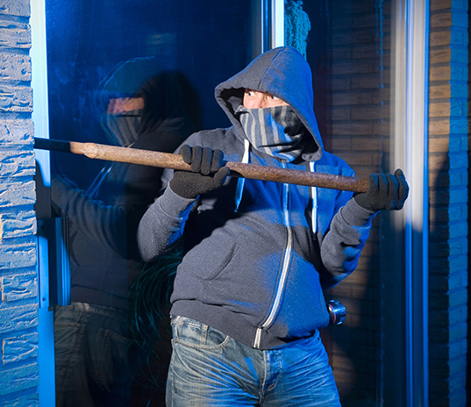
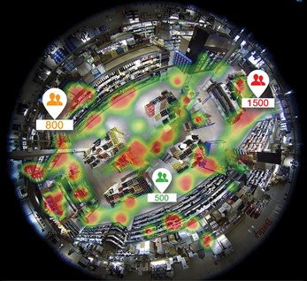
Challenges for Grocery Loss Prevention Teams
A challenge exists for grocers to find a cost effective, versatile Ai video solution that can be implemented quickly to improve security, gain actionable insights & enhance customer service. This solution must achieve a positive ROI for the organization in six months or less.

Slide 8

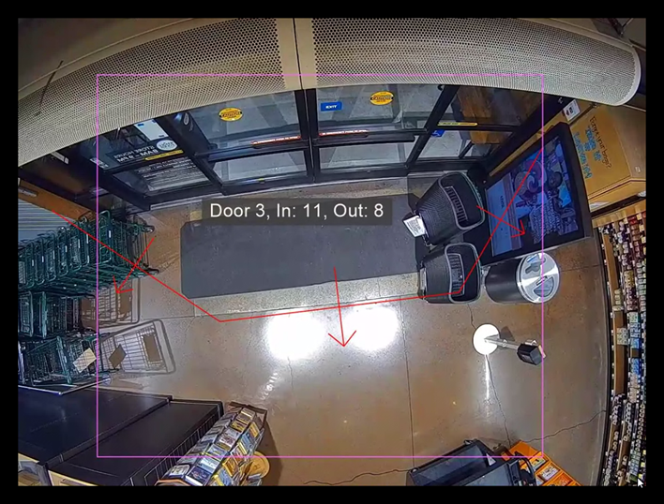
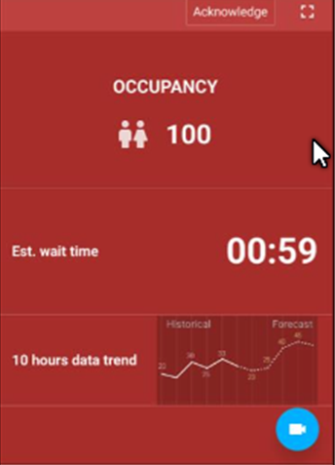
Understanding traffic and the effect on service for operation
Use video analytics to understand customer count and provide real-time alerts to store leadership in-order to to coordinate team member to provide better customer service
Notes:
Benefit of i3's smart video solution

Slide 9
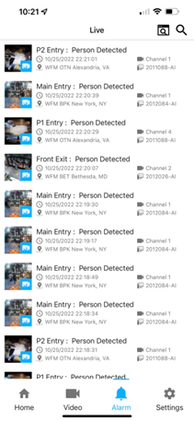
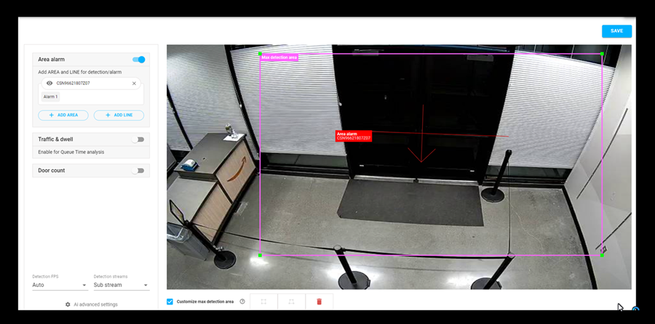
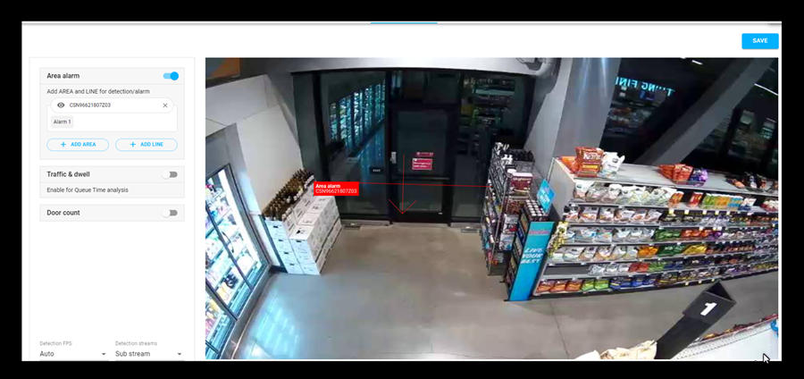

Using AI to help control emergency exits for safety
Real-time alerts generated through Ai detection can help store leadership control entry and exits points in a large facility
Notes:
Benefit of i3's smart video solution

Slide 10
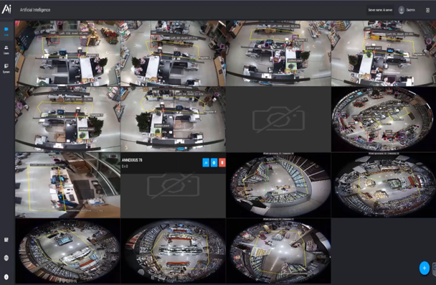
Labor management at the front end
Use video analytics to understand customer wait times, and throughput to help optimize labor while maintaining great customer service.
Play Video
Notes:
Benefit of i3's smart video solution

Slide 11
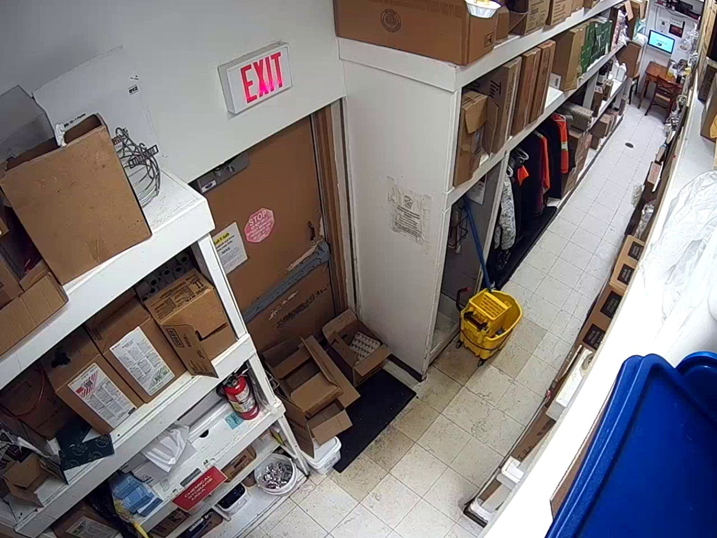
Help reduce OSHA fines
Use video analytics to sound alarms when exits doors or electrical panels are blocked and prevent expensive OSHA fines
Exit door blocked
Notes:
Benefit of i3's smart video solution

Slide 12
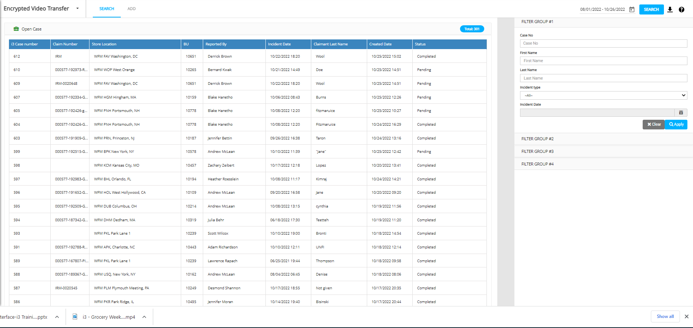
How the Risk and Legal Department can supported by AP

Slide 13
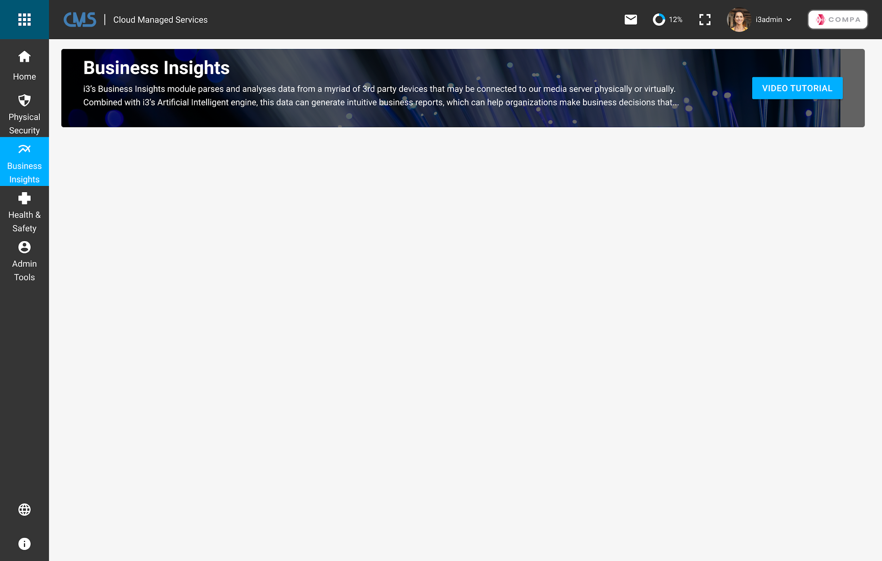
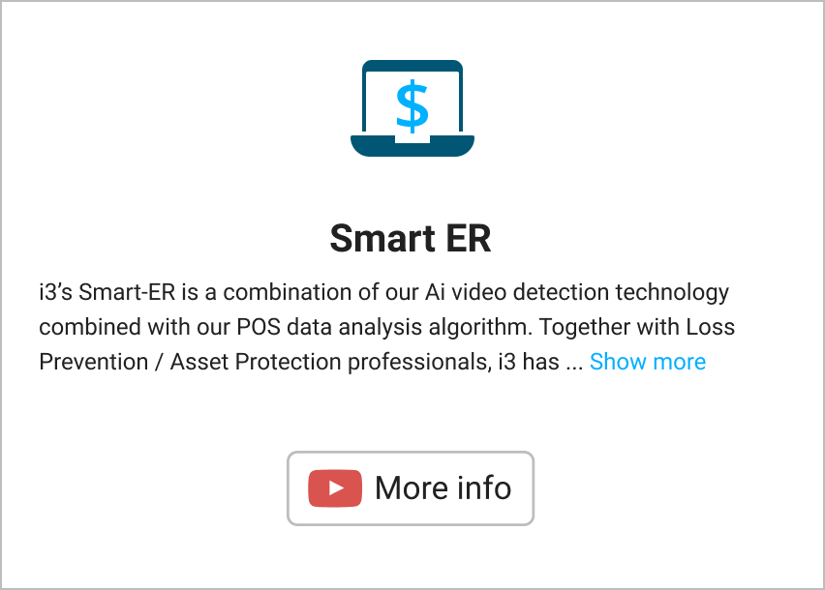
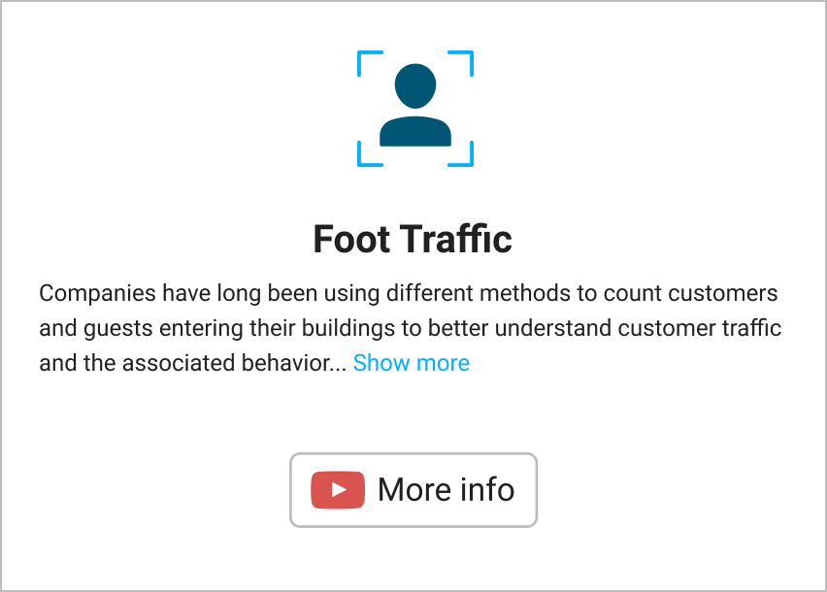
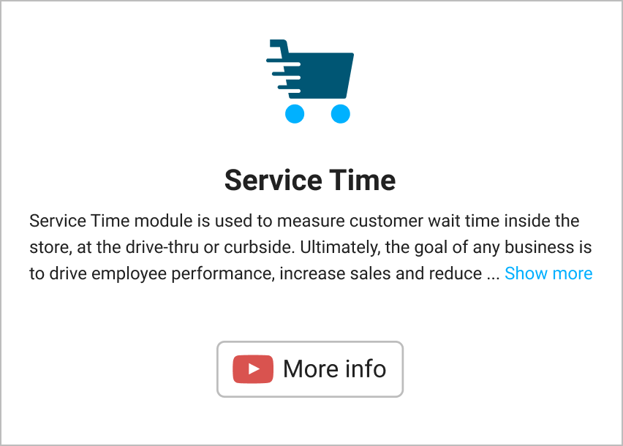
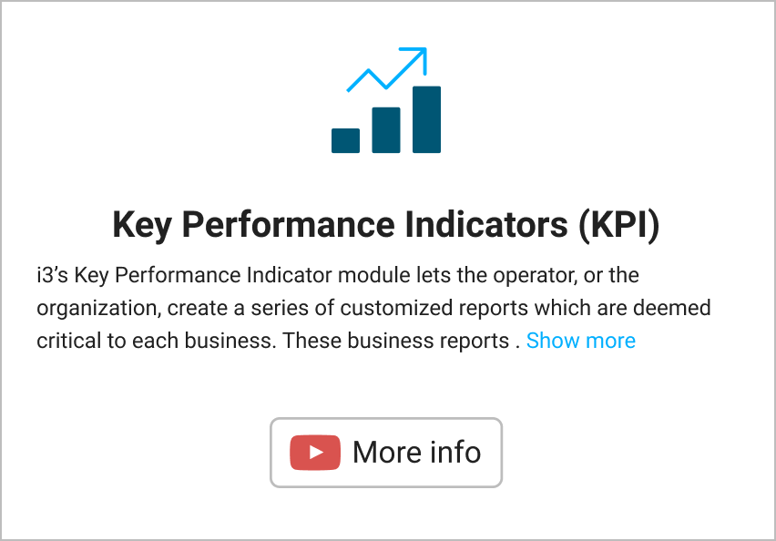
Easy portal access to Business Insights

Slide 14






Featured Case Study: Whole Foods
Whole Foods Solutions
500 locations with solutions implemented +390 sites
45-110 cameras
Utilizes many 360 cameras to cover large area
Implemented AI video analytics for operation, AP, safety
Implemented Encrypted Video Transfer (EVT) for the entire chain
Challenges
No standardized system
Customer Benefits
Limited resources and limited budget for the AP program
With the help of i3’s Ai platform, we can now use our traditional security equipment to gain advanced security features.
We have partnered with i3 to develop advanced Ai analytics that protect our customers and team members in a way that has not been done before. We have adopted technology can scale with the rapidly changing retail threat landscape.
Michael Limauro,
VP of Global Asset Protection, Whole Foods Market
Wanted to integrate camera systems with POS data and AI tools to gain actionable insights
Needed a single pane login and flexibility to share this platform with the entire organization

Slide 15
Top Referenceable Grocery Customers To Name Drop With Prospects
Customer | Solution Highlights | Locations
Weis Markets | POS integration with video to detect losses at the till | +200 locations across the USA
Cosentino | One of i3’s longest grocery customers - updated their system over 25 years | +35 including logistics centers
Harris Teeter | Full implementation and the only Kroger chain that was allowed to keep, updates and maintain its unique system topography | Full locations roll-out
Heines | Developing customer - will be testing cloud video in 2023 | +45 locations
Basha Foods | Mix of analog, HD and IP cameras across different regions. Video system needed to be integrated to POS. | All locations
Vallarta | Local regional grocer with large camera footprint. Video needed to work seamlessly on a small bandwidth pipe. Solution is being expanded in 2023 to include operations and marketing departments. | +50 locations
Whole Foods Markets | Mid-tier grocer with 500 locations. Currently deploying EVT, AI concierge level one support and EBR in 2023 | +390 location

Slide 16




Competitive Landscape for BI solutions for Grocers

Slide 17


Initial Pitch
“Hi (first name of potential customer) ….My name is XYZ and our company has been working with many grocers like “retail-name drop” Whole Foods, Weis Markets, Harris Teeter, to help extend their current video technology platform to support AI with integrated POS. Would you have some time to set up a meeting with our subject matter expert to share our use cases and benefits to retailers like you?”
Typical Decision Makers
Heads of OPs, CTO, CIO, AP/LP, IT, Risk Management
Owner
Sales Tips
Get the decision maker involved early
Ask pointed Discovery questions besides BANT:
  Do you have a scalable cloud base video system?
  Does your existing video system support Ai to help improve labor cost and increase sales?
  Does your video system all you to share large video clips with third party insurer securely through the cloud?
Tailor proposal with their needs with minimal options
Understand their costs and provide ROI
Typical Influencers
District Manager or General manager
Ops/facility manager
Franchise Board, Investor Groups or Advisory Groups
Consultants and Secondary Vendors (POS companies)
Industry groups/sites: FMI, LPM, RILA, NRF

Slide 18
Business Insights - FAQs
What are the key business drivers for Grocery Business Insights/Video Analytics solution?
What types of cameras are supported?
What is the duration of a typical project?
Will we support a POC? Maximum length?
What key integrations with other retail apps are important to understand?
How do I pitch against someone who has ShopperTrak, RetailNext or Prism as their video analytics tool?

