Slide 1

Week 1
QSR
Smart POS Exception Reporting
Business Insights
Drive-thru
Week 2
Retail
Cloud VMS & Extended Storage
Smart POS Exception Reporting
Business Insights
+
Training
Series
Week 3
Grocery
Smart POS Exception Reporting + Integrated VMS
Business Insights & Encrypted Video Download
Week 4
C-Stores & Carwash
Incident Reporting & Cloud Storage
POS Reporting & Business Insights

Slide 2
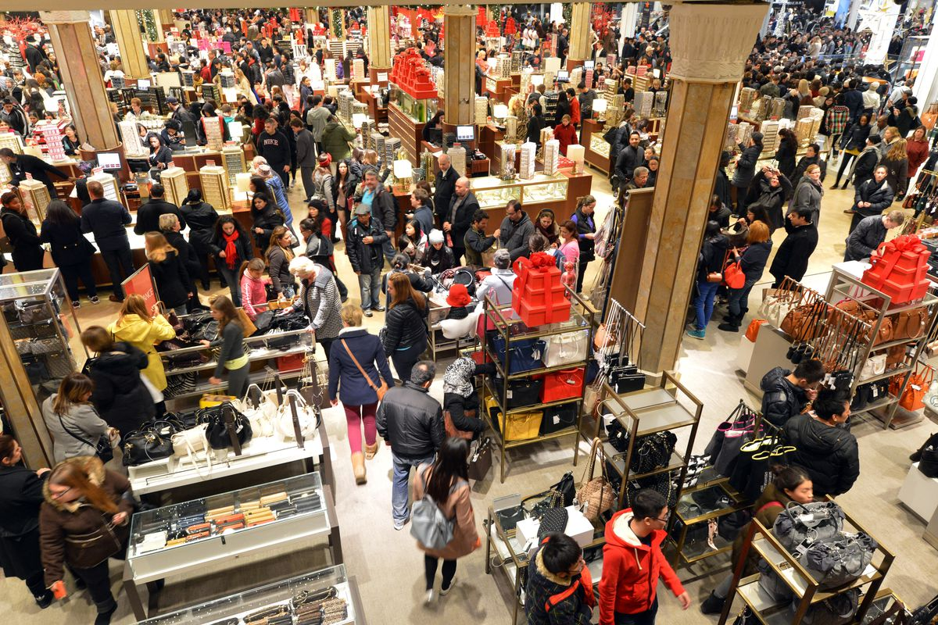
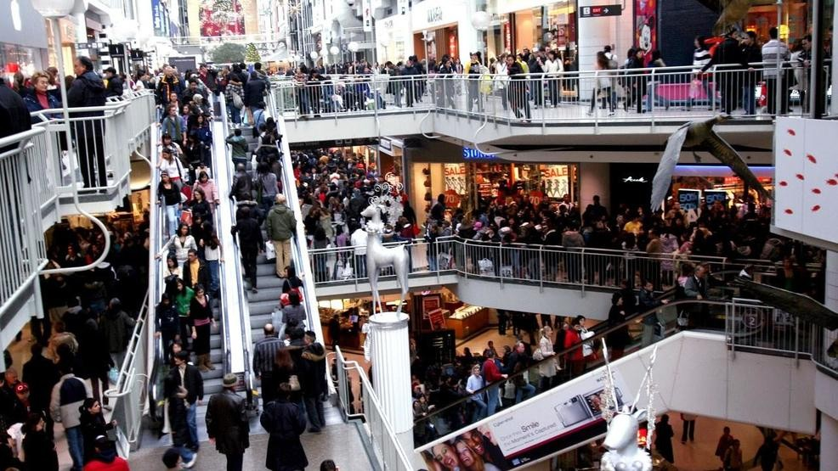
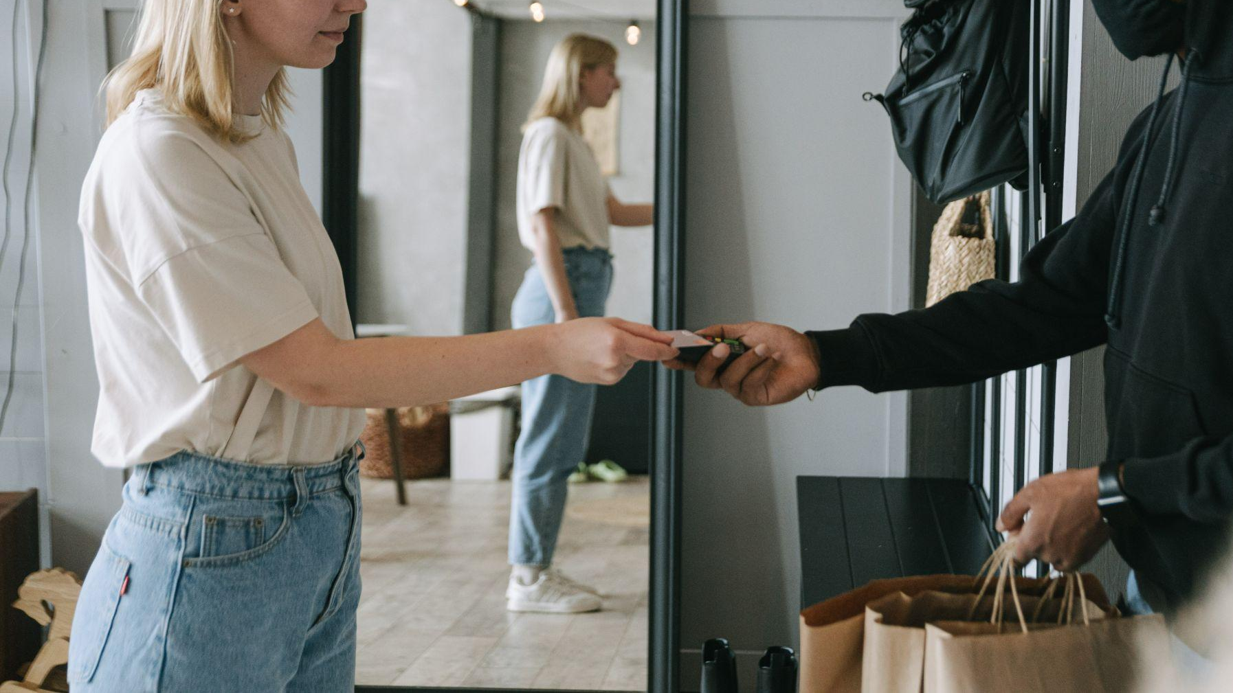

Business Insights for Retail
Driving Actionable Intelligence

Slide 3
Business/Sales Drivers
High Level Solution, Architecture & Use Cases
Video Analytics Demo
Case Studies
Sales Summary: Buyers & Pitch
FAQs
+
Training
Agenda

Slide 4
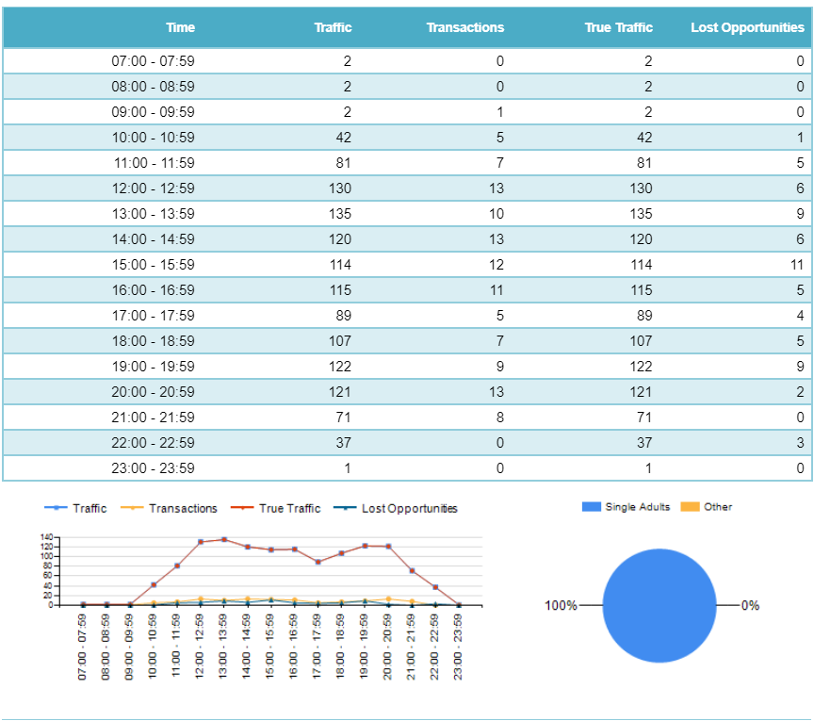
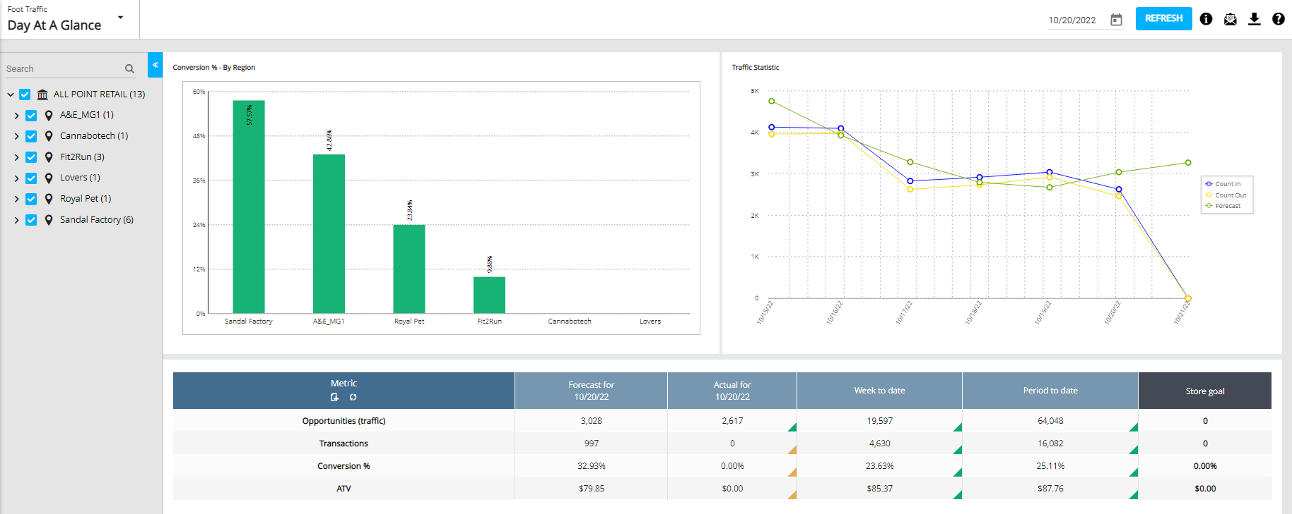
Sales Drivers for Business Insights
Operations improvement
Retailers are looking for data points that can help them measure a store’s performance beyond revenue
Retailers are looking to maximize their labor force
Retailers are looking for real-time actionable data to motivate their teams and personalize the guest experience
Revenue improvement
Retailers want to standardize metrics to ensure repeat business and higher average transactions
Retailers want to lower analytics costs by leveraging existing infrastructure
Retailers wan real-time actionable data to motivate associates to increase their average ticket sales

Slide 5
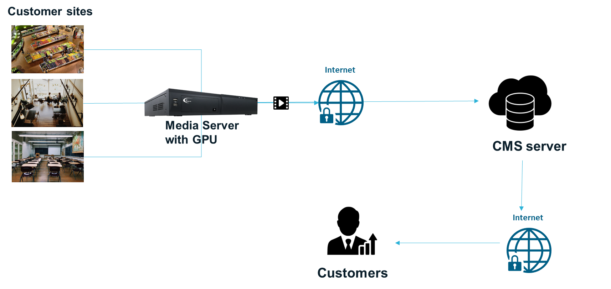
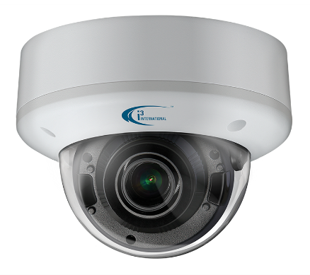
High Level Solution Diagram - Edge Analytics: Real time data at site
Notes:
Analytics on the media server - there is a powerful graphics card - Can analyze data real time on site but extra cost - real -time

Slide 6
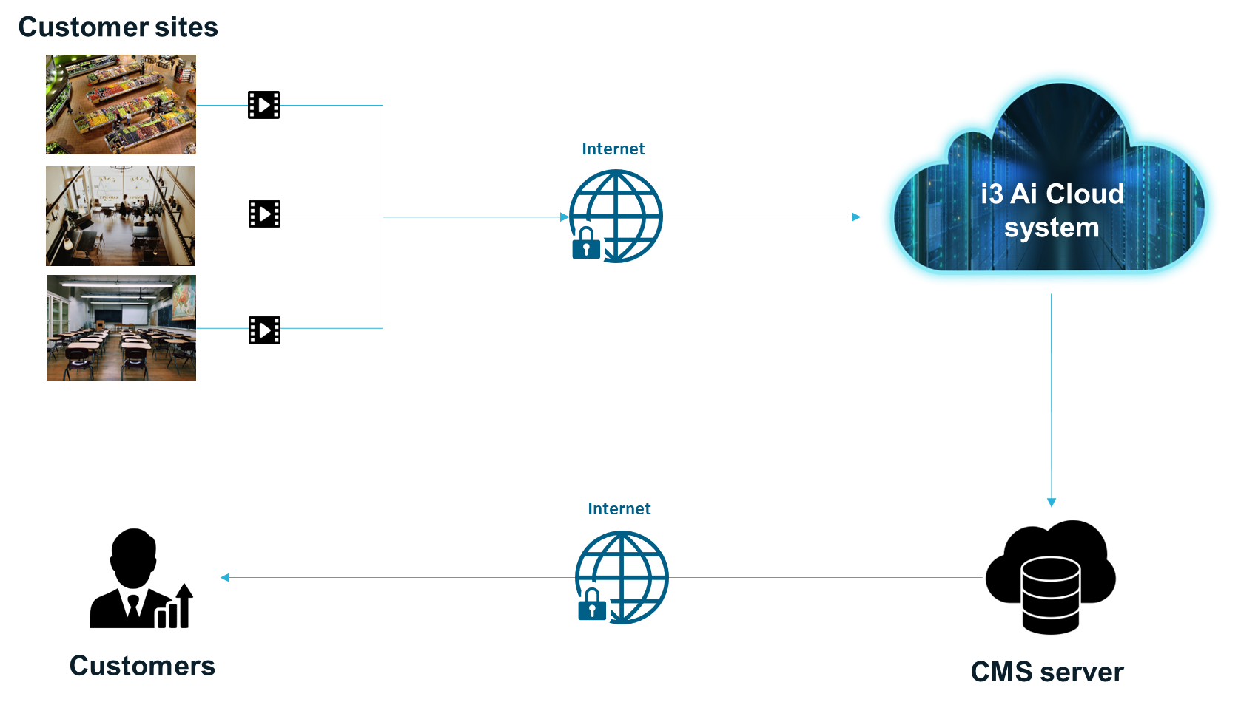

High Level Solution Diagram - Award Winning Cloud Analytics
Notes:
WIthout hardware -send data to cloud and analyze data in the cloud - send as much data - saves cost - More

Slide 7

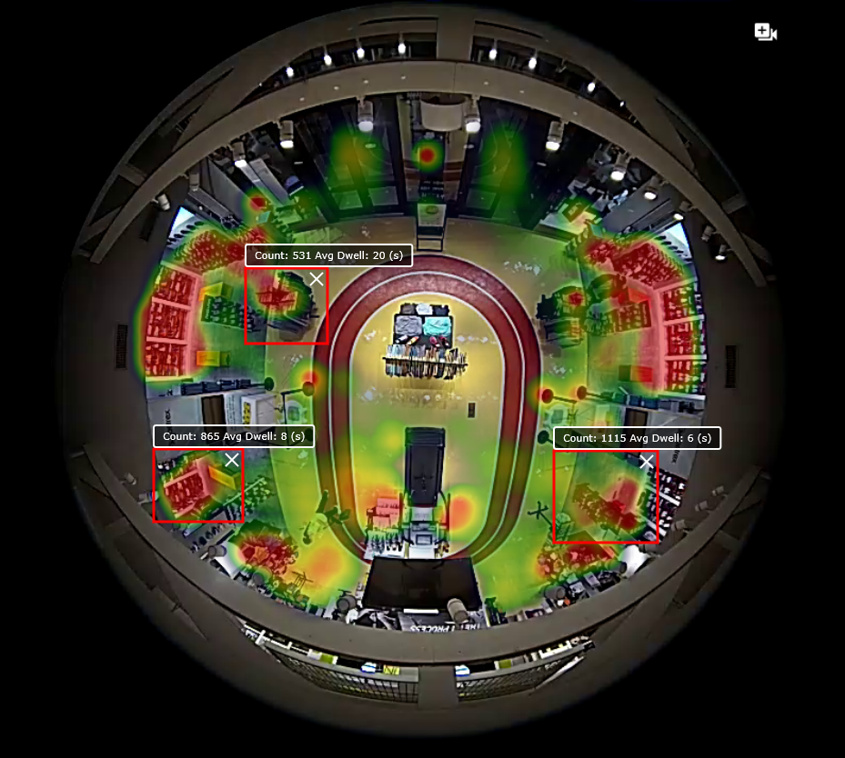





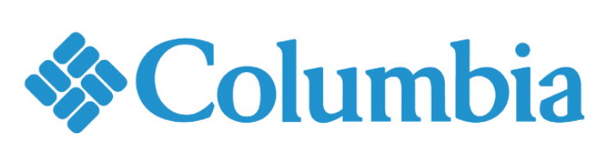

Understanding complete customer journey
Use video analytics to understand customer count, wait times, heat mapping as well as key regions of interest.
Play Video
Notes:
Benefit of i3's smart video solution

Slide 8
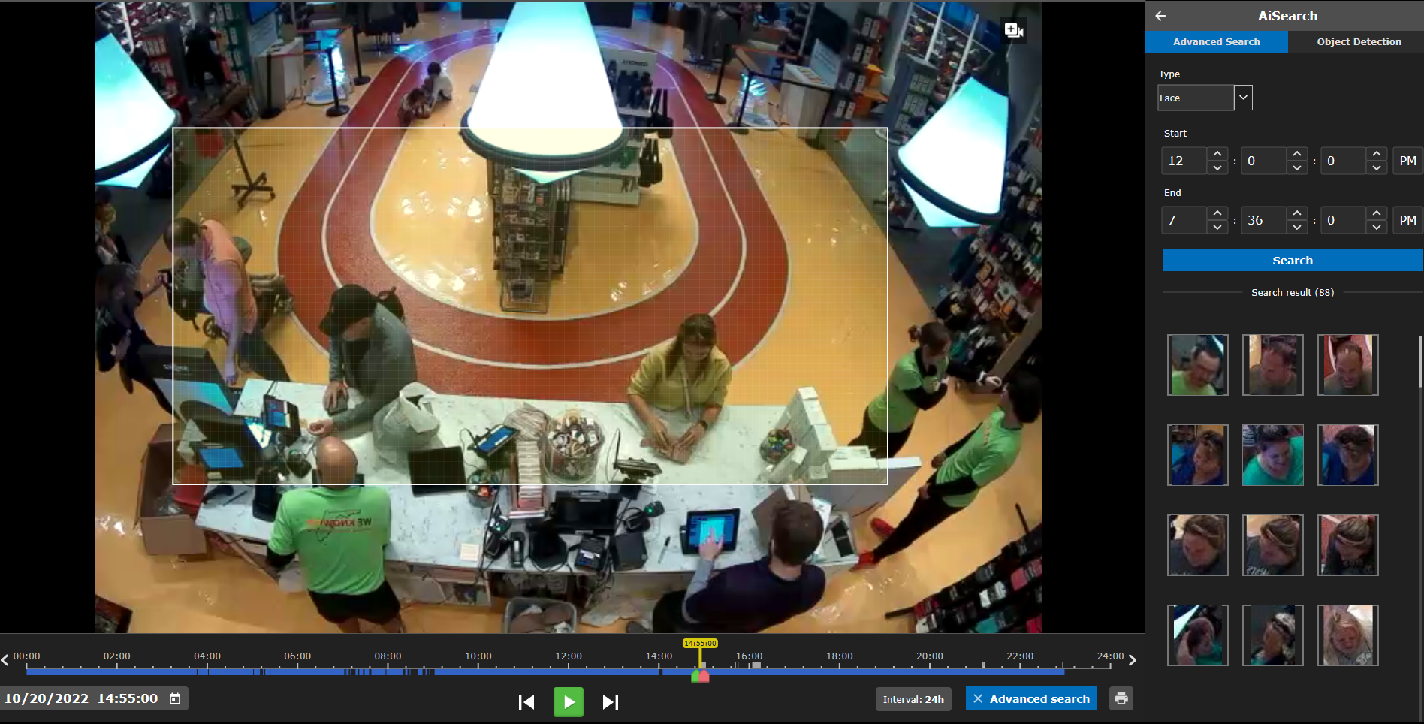
Measuring repeat customers
Patented image “matching” engine understands how frequently loyal customers purchase from a particular location.
Notes:
Benefit of i3's smart video solution

Slide 9
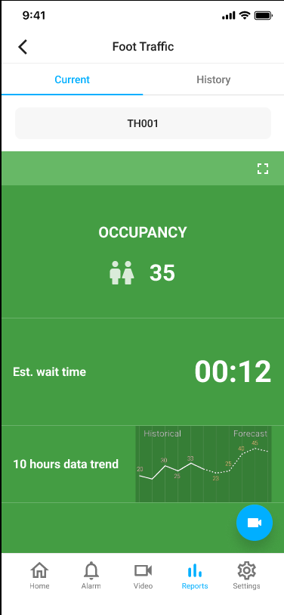
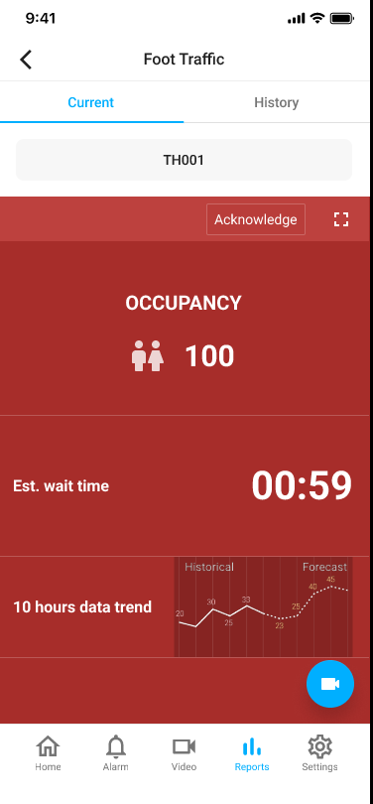
Delivering real-time actionable data from each location
Using i3’s secured cloud, retailers can communicate with their associates in real time to help increase sales and deliver exceptional customer service.
Notes:
Benefit of i3's smart video solution

Slide 10
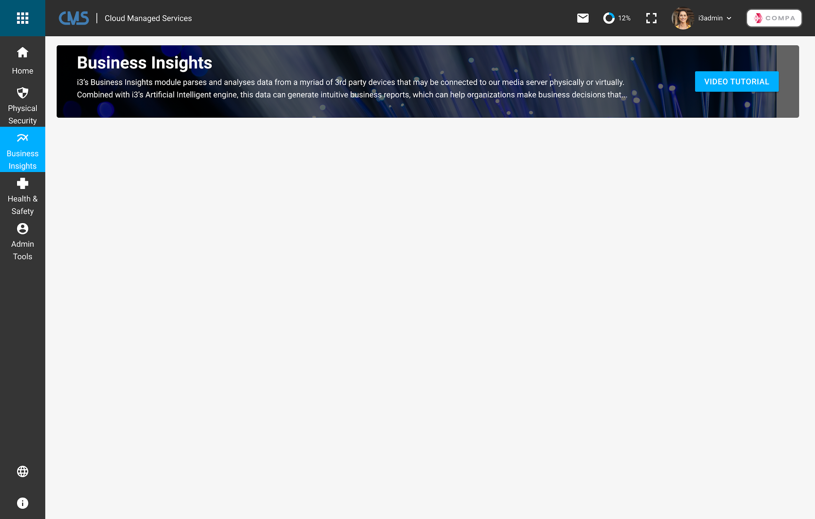
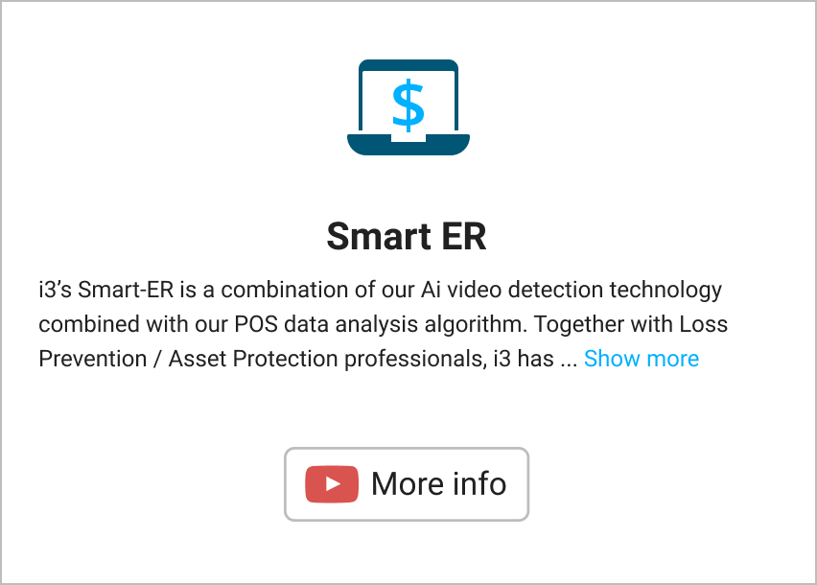
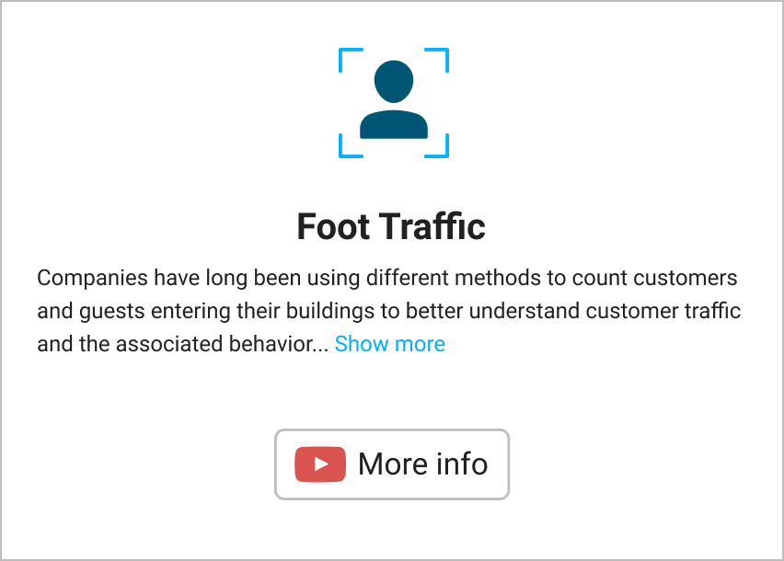
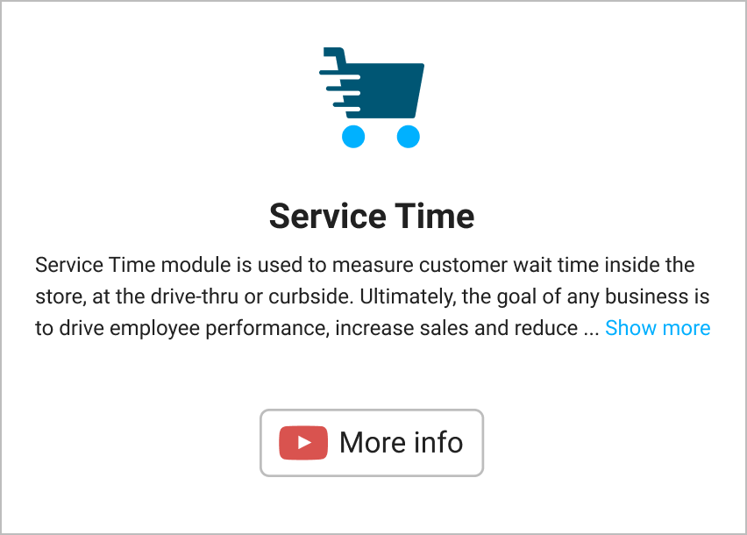
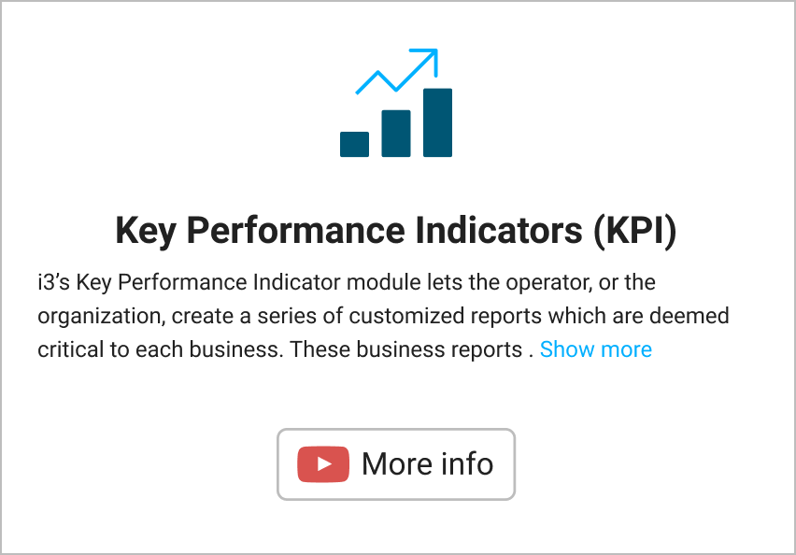
Easy portal access to Key Business Metrics

Slide 11



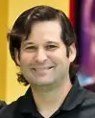


Case Study
15 locations currently serviced in 3 states.
Business Intelligence Solution
8-16 cameras per location
Ability to count customers
Ability to measure queue-time
Ability to measure customer engagement with merchandise
Ability to deliver real-time reports to management team
Challenges
NO Integration of POS with
video systems
Customer Quote
Fast growth, challenge with labor cost and speed of service
“Understanding customer count and how our employees are interacting with our guests is a critical data point that we measure daily. i3 has allowed us to do this and more.”
Park Robinson,
Founder
Wanted to integrate camera system with Ai to help managers and management run a better store
Needed real-time actionable data to help drive operational improvements

Slide 12
Top Referenceable Retail Customers To Name Drop With Prospects
Customer | Solution Highlights | Locations
Goodwill | POS integration with video to detect losses at the till | +200 locations across the USA
Northern Tools | POS integration with video, often on existing infrastructure. Combination of HD, IP and analog cameras | +140 including logistics centers
Tileys | Secure platform to replace aging Intellex unit | +100 and continuing growth for all locations
Dollar General | Developing specialty cameras to reduce install time - will be testing cloud video in 2023 | +2000 locations
DTLR | Mix of analog, HD and IP cameras across different regions. Video system needed to be integrated to POS and store analytics for counting and heat-mapping | 250 locations
Gabes | Local regional discount fashion retailer with large camera footprint. Video needed to work seamlessly on a small bandwidth pipe. Solution is being expanded in 2023 to include operations and marketing department. | 122 locations

Slide 13



Competitive Landscape for Retail Business Insights
Strengths | Weaknesses | Opportunities
Established name brand within retail Full operation and AP solution Full reporting suite Can track customer through Ai or HW monitoring Leadership team are comprised of former retailers Strong customer success team | Charges top dollars for technology solution Proprietary costly counting HW Video surveillance features are lacking Can not utilize existing cameras Deployment often late and over budget | When going against Retailnext on a green field project go in with the idea that the solution being offered can utilize some or all of the existing video infrastructure. This will have a large impact on the implementation cost since there may be very little to new hardware needed to achieve the result the retailers are looking for.
Largest market share and brand recognition Most experience Has the ability to compare traffic and conversion across an entire segment Can implement quickly through JCI Insightful dashboards and strong integration to their own AP platform (Sensormatic) | Very little integration for past decade Service is lacking due to merger and consolidation of Shoppertrak with JCI Can not go beyond the door | The opportunity with Shoppertrak is to see if the retailer is dissatisfied with the services or if the retailer want to understand traffic flow beyond the door way. Being able to expand the customer journey beyond the door and into the entire store make the i3 product more appealing to most retailers especially when they can utilize their existing infrastructure to do this.
Low cost for small implementation Minimal HW SW can be loaded onto supporting camera HW like Axis | Over promise Basic reports and metric Just detecting and tracking but does not have the complete operational & security solution | Prism Labs is a good technology on small scale implementation that require very basic data sets and reporting. The opportunity when going against Prism is to discuss how the retailers existing video infrastructure can be reuse to gain deeper insight into their customer journey with having a need to rip and replace.

Slide 14


Initial Pitch
“Hi (first name of potential customer) ….My name is XYZ and our company has been working with many retailers like “retail-name drop” DG, Five Below, DTLR, Columbia have a better understanding of their customer journey through out the store utilizing their current video technology platform. Would you have some time to set up a meeting with a subject matter expert to share our use cases and benefits to retailers like you?”
Typical Decision Makers
Heads of OPs, Marketing, IT
Owner
Sales Tips
Get the decision maker involved early
Ask pointed Discovery questions besides BANT:
  Is customer counting an initiative this year?
  Is your operation group interested in tracking the guest beyond the front door?
Tailor proposal with their needs with minimal options
Understand their costs and provide ROI
Typical Influencers
District Manager or General manager
Ops/facility manager
Franchise Board, Investor Groups or Advisory Groups
Consultants and Secondary Vendors (POS companies)
Industry groups/sites: RLPSA, LPM, QSR magazine

Slide 15
Business Insights - FAQs
What are the key business drivers for Retail Business Insights/Video Analytics solution?
What are the key benefits to a retailer with our business analytics solution?
Who are the top competitors that i3 runs into in the Retail Business Insights space ?
Will we support a POC? Maximum length?
What key integrations with other retail apps are important to understand?
How do I pitch against someone who has ShopperTrak, RetailNext or Prism as their video analytics tool?

