Slide 1

Week 1
QSR
Smart POS Exception Reporting
Business Insights
Drive-thru
Week 2
Retail
Cloud VMS & Extended Storage
Smart POS Exception Reporting
Business Insights
+
Training
Series
Week 3
Grocery
Smart POS Exception Reporting + Integrated VMS
Business Insights & Encrypted Video Download
Week 4
C-Stores & Carwash
Incident Reporting & Cloud Storage
POS Reporting & Business Insights

Slide 2
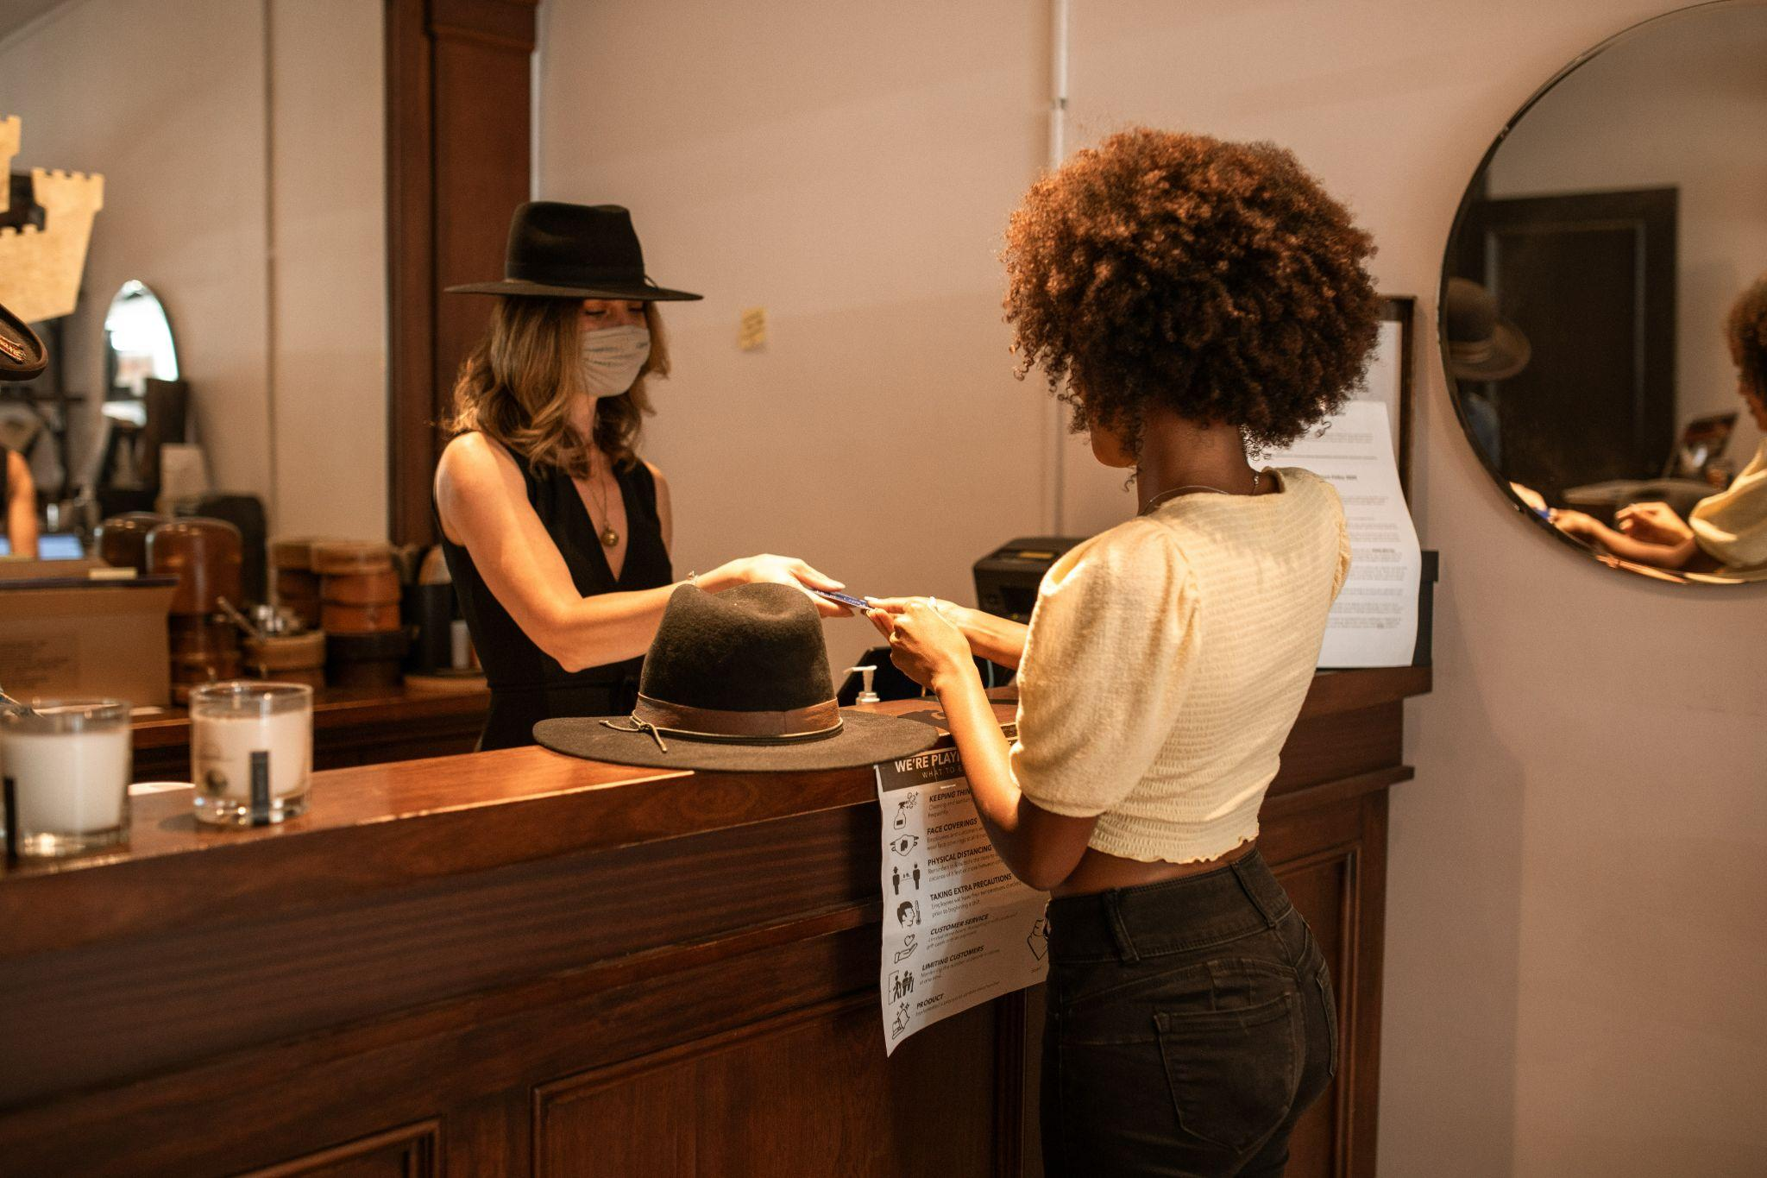
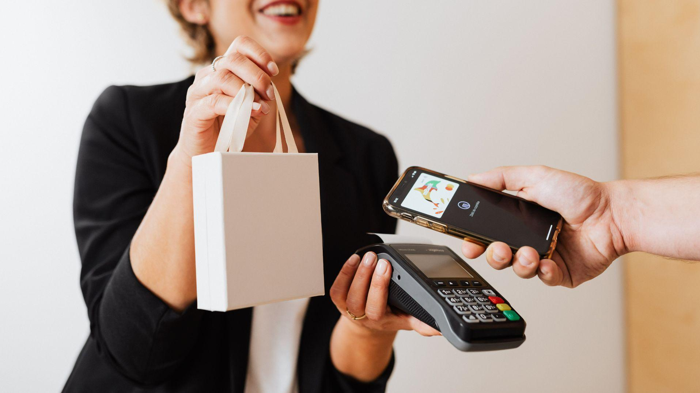

Smart POS Exception Reporting for Retail
+
Driving Profitability

Slide 3
Business Drivers
High Level Solutions, Architecture & Use Cases
Exception Based Reporting Demo
Case Studies
Competition
Sales Summary: Buyers & Pitch
FAQs
+
Training
Agenda

Slide 4
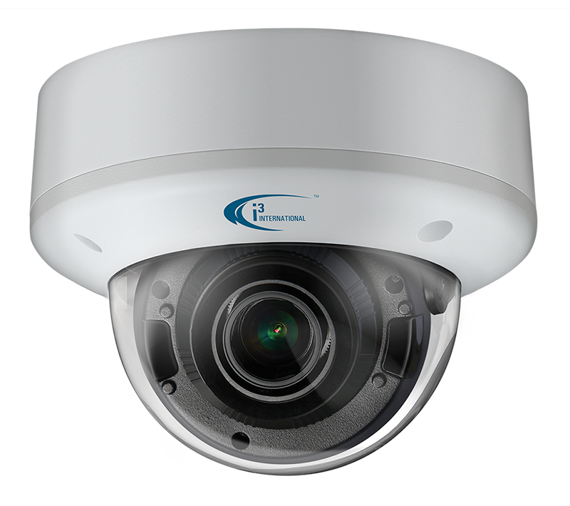

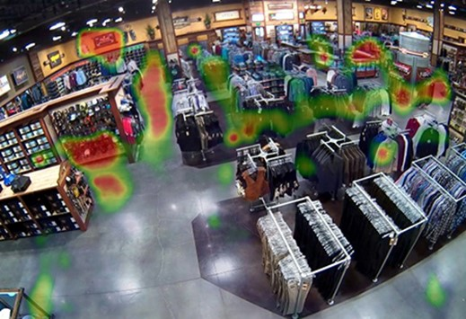
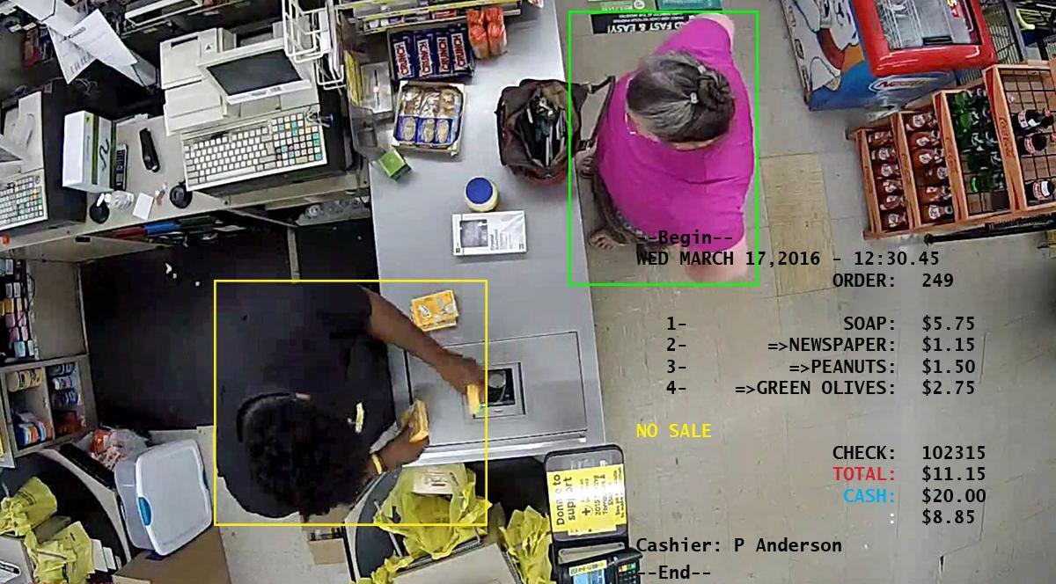
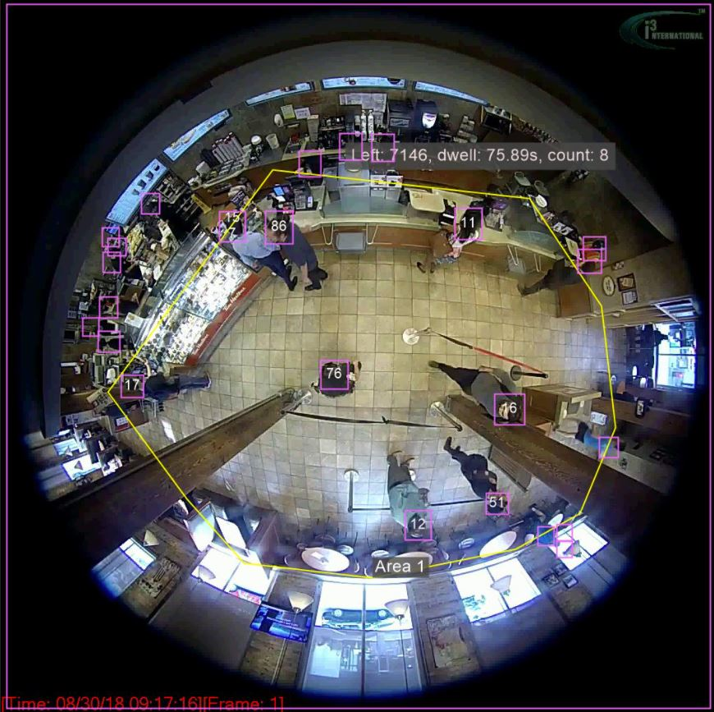
Sales Drivers for Retail POS Exception Reporting
Consolidation and mergers in the EBR space - increased solution cost and reduced personalized service
Need to control loss and eliminate internal theft
Shortage in labor - need to reduce managers’ time for investigations
Tougher PCI/PII Compliance needs are forcing some operators to change platforms
Adding new locations or expanding or remodeling stores
Contract expiration on current vendor- cost cutting opportunity
Fiscal year end - tax benefits and budget overflow for tech spend

Slide 5
Challenges for Retail Loss Prevention Teams
Retail LP teams need to find a cost effective, versatile AI-based video solution that can be implemented quickly to reduce shrink and prevent loss. This solution must achieve a positive ROI for the organization in six months or less.

Slide 6
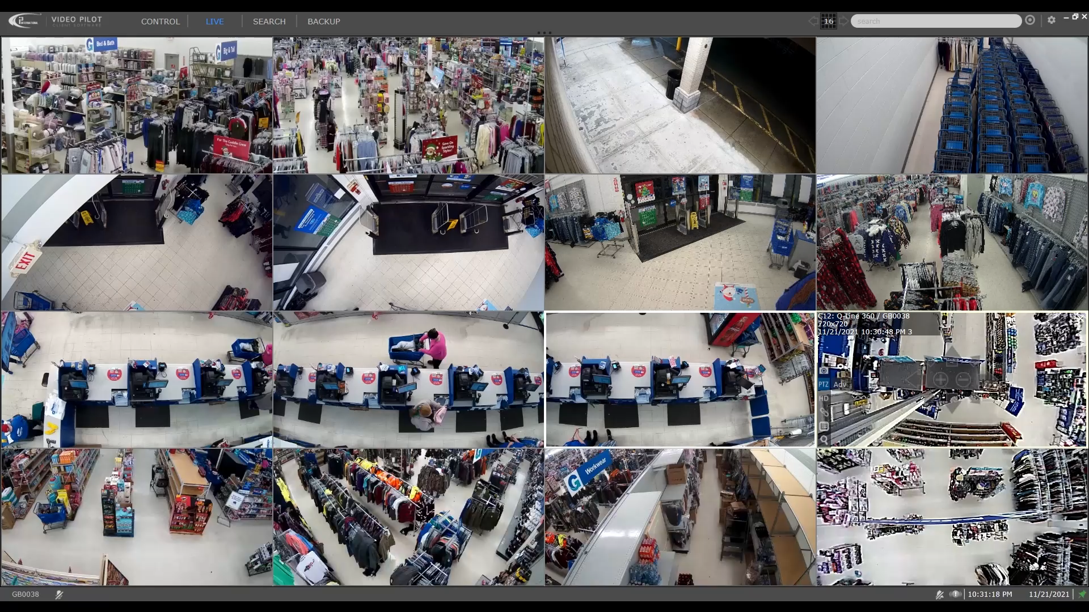
Traditional security video has been used as a reactive tool for liability and theft review
Play Video

Slide 7
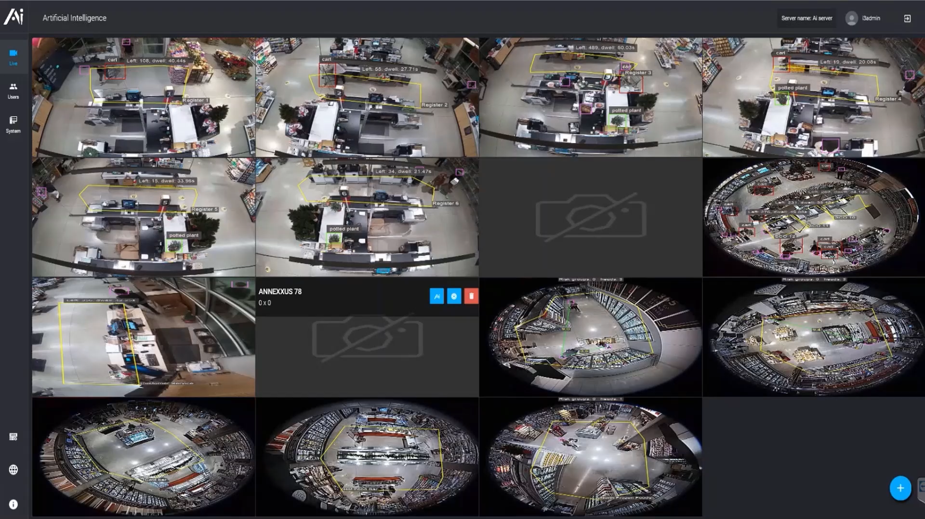
How AI & machine learning can benefit the retail operator
Play Video
Notes:
Benefit of i3's smart video solution

Slide 8

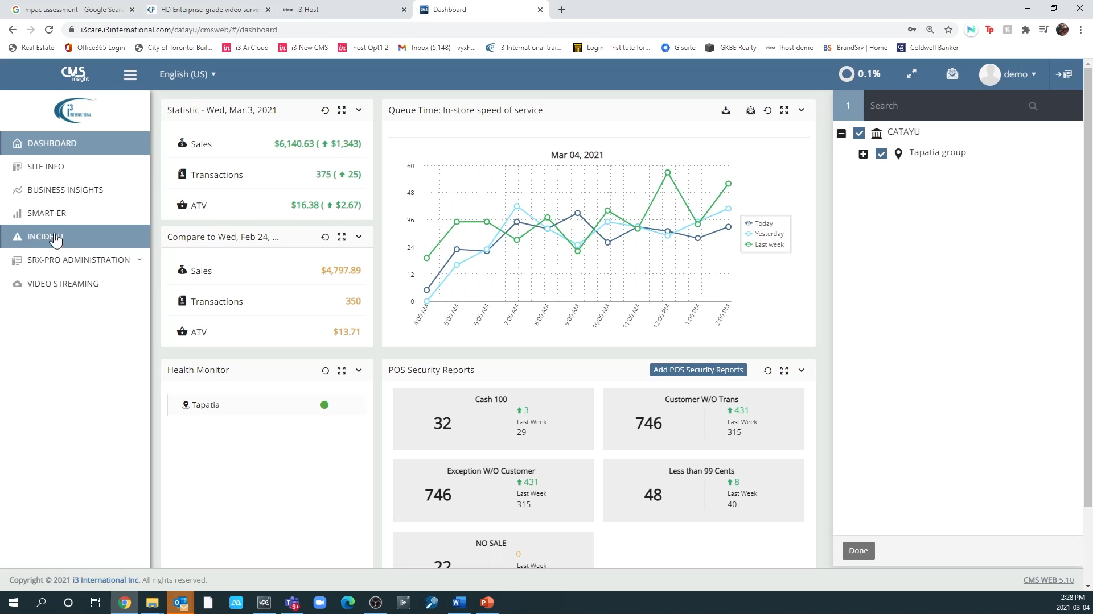







Employee theft can be stopped at the till by using i3’s data analytics engine
By integrating video with the POS data, operators can detect potential theft due to till manipulation.
Play Video
Notes:
Benefit of i3's smart video solution

Slide 9
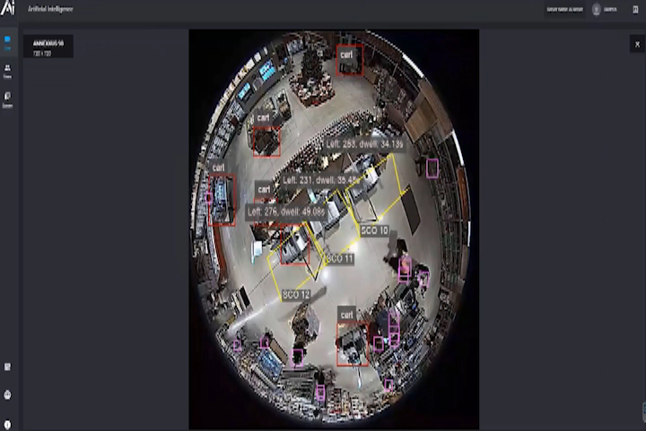
EBR can be enhanced with AI and machine learning
i3’s patented video analytics engine with integrated POS data helps detect suspended transactions and refunds without customers.
Play Video
Notes:
Benefit of i3's smart video solution

Slide 10
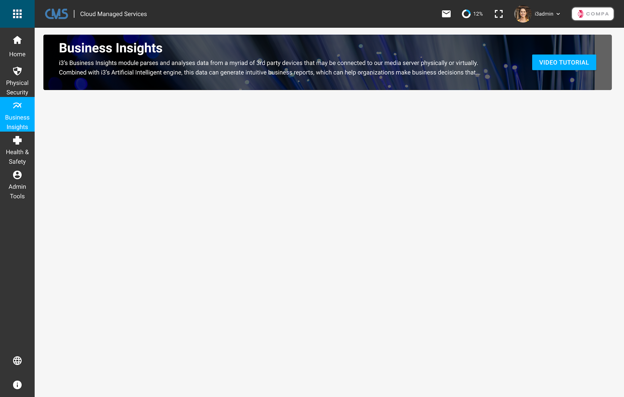
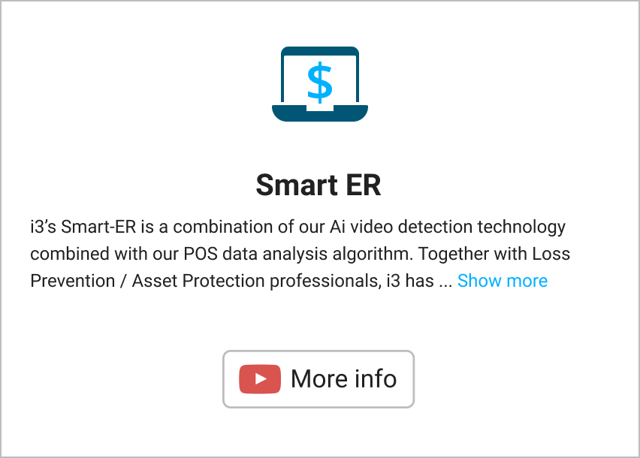
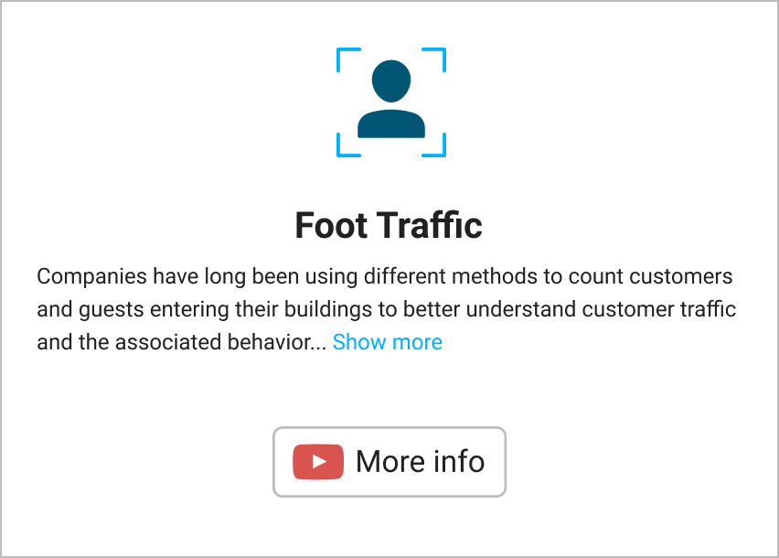
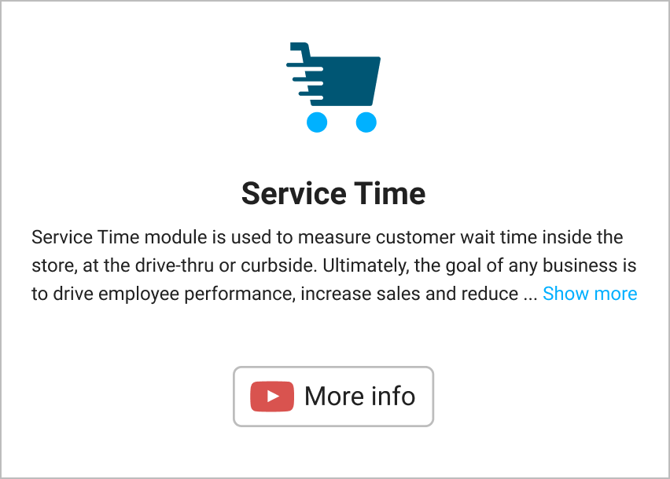
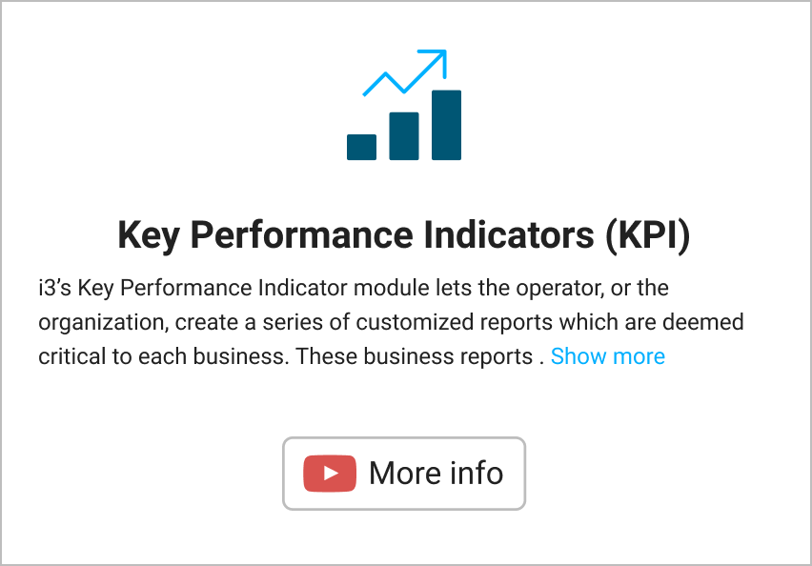
Easy portal access to Exception Based Reporting

Slide 11
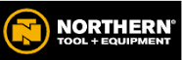





Case Study
120+ locations currently serviced in 20 states.
POS Exception Reporting Solution
16-24 cameras per location
POS exception reporting with integrated video
Challenges
NO Integration of POS with
video systems
Customer Quote /Benefits
Fast growth, Small IT team
with small LP team
“We needed to control loss at the till and wanted managers and other members to help in detecting suspicious activities
I would definitely recommend the i3 Exception based reporting to others. . When we have an issue, they are quick to respond, and we get all of our information in one easy to use portal.”
– Todd Gulbranson, Director of Loss Prevention
Wanted to integrate camera system with POS data and AI
Needed single pane login and view for all cameras

Slide 12
Top Referenceable Retail Customers To Name Drop With Prospects
Customer | Solution Highlights | Locations
Goodwill | POS integration with video to detect losses at the till | +200 locations across the USA
Northern Tools | POS integration with video, often on existing infrastructure. Combination of HD, IP and analog cameras | +140 including logistics centers
Tileys | Secure platform to replace aging Intellex unit | +100 and continuing growth for all locations
Dollar General | Developing specialty cameras to reduce install time - will be testing cloud video in 2023 | +2000 locations
DTLR | Mix of analog, HD and IP cameras across different regions. Video system needed to be integrated to POS and store analytics for counting and heat-mapping | 250 locations
Gabes | Local regional discount fashion retailer with large camera footprint. Video needed to work seamlessly on a small bandwidth pipe. Solution is being expanded in 2023 to include operations and marketing department. | 122 locations

Slide 13



Competitive Landscape for Retail POS Exception Reporting
Strengths | Weaknesses | Opportunities
Established name brand within retail Large corporation with a specialty in health and retail Many operators use many parts of Appriss SW components to run their retail Has a large development and support team Strong predictive data engine Large legacy customer base | Expensive and price is increasing Service is lacking due to merger and consolidation of Sys. Republic and Aspect LP Over promise to keep the customer and often under deliver | Appriss is expensive and has underperformed. Many retailers are starting to look at other options to replace their old Aspect solution because they do not want to shift to the new Secure platform. With multiple EBR companies being purchased by large firms including Aspect and Sys-Republic services, pricing is starting to change.
Known for their technology in supply chain Profitec by Zebra is known for its data analysis beyond AP/LP Can tie in inventory data and logistic data to help give a more complete store picture in the retail business | Recently purchased by Zebra and will have some internal competition against the other Zebra brands Support is waning since most of their core people have left | The opportunity with Profitect is that they were a specialty company with a focus on data analytics for AP. Unfortunately with the purchase by Zebra a lot of their former customers are not getting the same service. Enquire if end-users are happy with their current platform. Pitch to enhance their existing functionality with video Ai and get a small piece of the business to start. Offer a POC.
Great support and onboarding Easy to use and train on Strong in grocery and pharmacy Strong list of integration partners including i3 Cloud Based Analytics | High upfront cost to parse the POS data Video application playback is weak No Video AI engine to improve EBR reports | Many operators are dissatisfied with their current platform. Pitch them a POC to enhance the EBR functionality with Video AI and start with a small part of their business.

Slide 14


Initial Pitch
“Hi (first name of potential customer) ….My name is XYZ and our company has been working with many retailers like “retail-name drop” DG, Five Below, DTLR, Columbia to help extend their current video technology platform to support AI, integrate with POS and enhance cloud storage capabilities. Would you have some time to set up a meeting with a subject matter expert to share our use cases and benefits to retailers like you?”
Typical Decision Makers
Heads of AP/LP, Finance, IT, Risk Management
Owner
Sales Tips
Get the decision maker involved early
Ask pointed Discovery questions besides BANT:
  Do you have an EBR platform that you are working with?
  Does your existing EBR system integrate with video?
  Does you current EBR system integrate with video analytics to enhance fraud detection?
Tailor proposal with their needs with minimal options
Understand their costs and provide ROI
Typical Influencers
District Manager or General manager
Ops/facility manager
Franchise Board, Investor Groups or Advisory Groups
Consultants and Secondary Vendors (POS companies)
Industry groups/sites: NRF, LPM, RILA

Slide 15
POS Exception Reporting - FAQs
What are the key business drivers for Retail POS Exception Reporting?
What types of cameras are supported ?
What are the key stages in a POS implementation project?
What is the duration of a typical project ?
Will we support a POC? Maximum length?
What key integrations with other retail apps and key POS systems are important to understand?
How do I pitch against someone who has Solink as their POS exception reporting tool?

